Slide 1
EUV spectroscopy: connecting the corona to the heliosphere
Dr Peter Young
George Mason University, USA
NASA Goddard Space Flight Center, USA
Northumbria University, UK
Hinode/EIS [2006-]
IRIS [2013-]
10 Å=1nm Fe XX=Fe¹⁹⁺

Slide 2
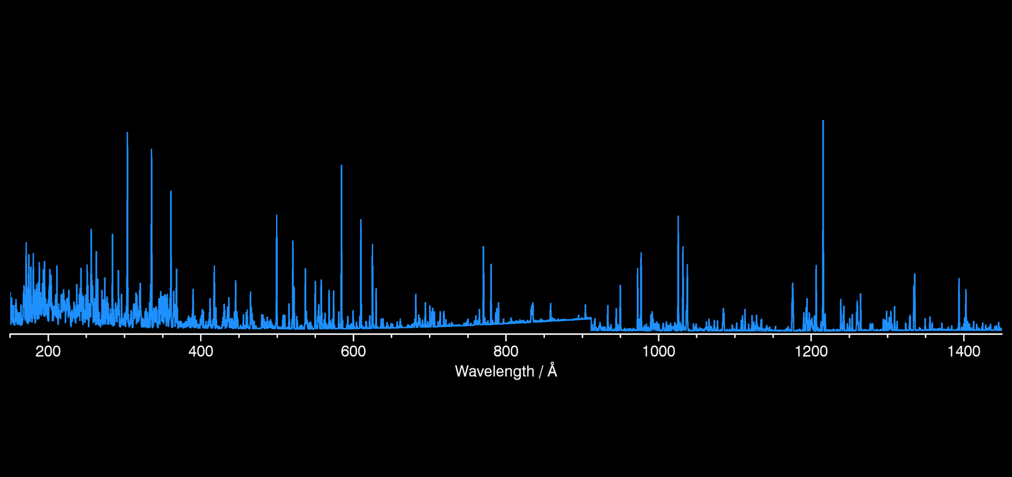
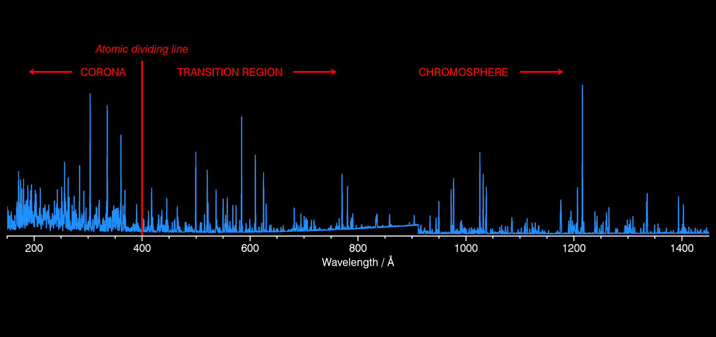
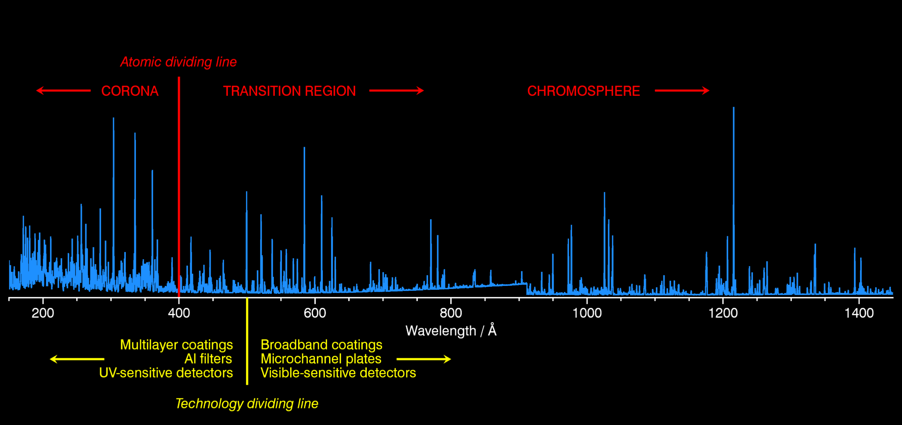
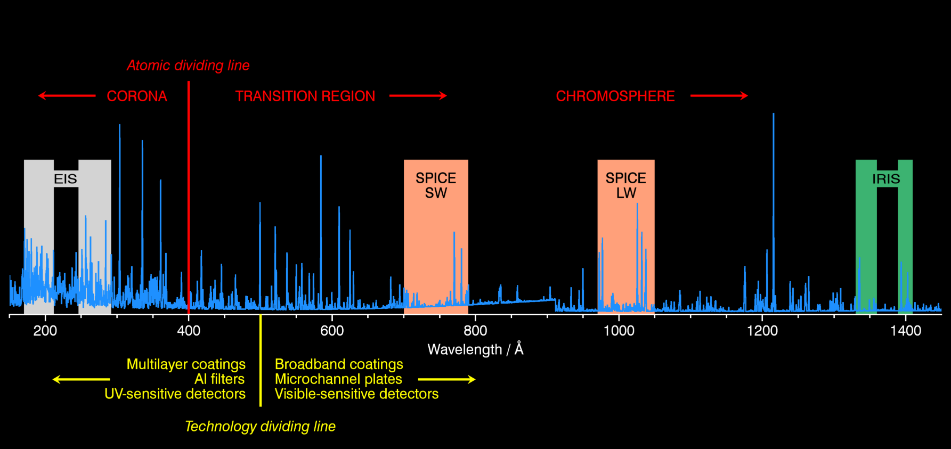
The EUV solar spectrum
Synthetic spectrum from CHIANTI

Slide 3
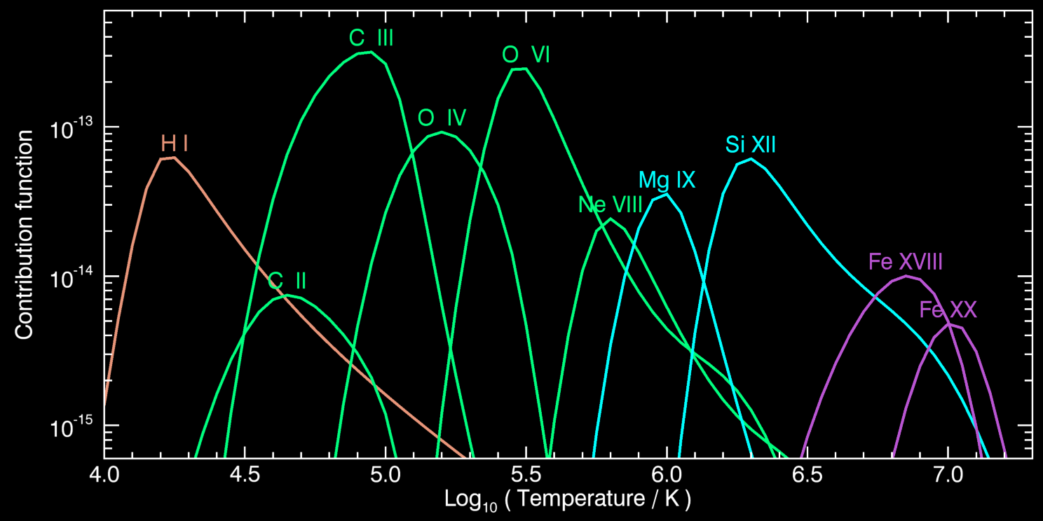
SPICE wavelength bands
Most complete temperature coverage of any UV spectrometer
Ion | Wavelength | Temp
H I | 1025.7 | 15 kK
C II | 1037.0 | 45 kK
C III | 977.0 | 90 kK
O IV | 787.7 | 140 kK
O VI | 1031.9 | 300 kK
Ne VIII | 770.4 | 600 kK
Mg IX | 706.1 | 1 MK
Si XII | 520.7 (x2) | 2 MK
Fe XVIII | 974.9 | 7 MK
Fe XX | 721.6 | 10 MK

Slide 4
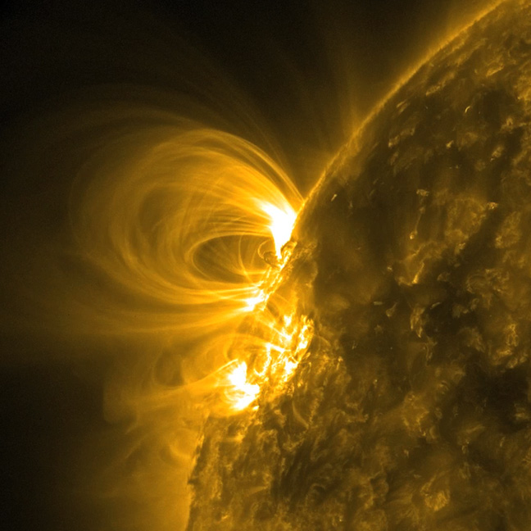
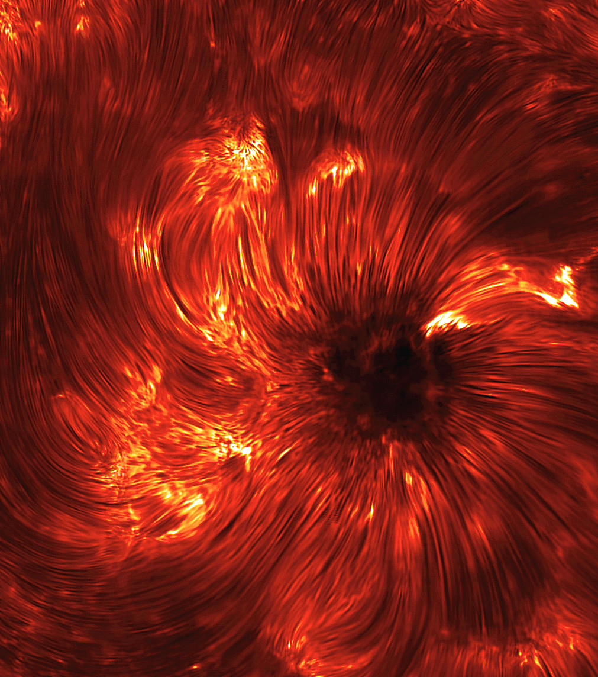
Imaging the solar atmosphere
Corona
Chromosphere
AIA 171 Å
IBIS Ca II 8542 Å core
What about the transition region?

Slide 5
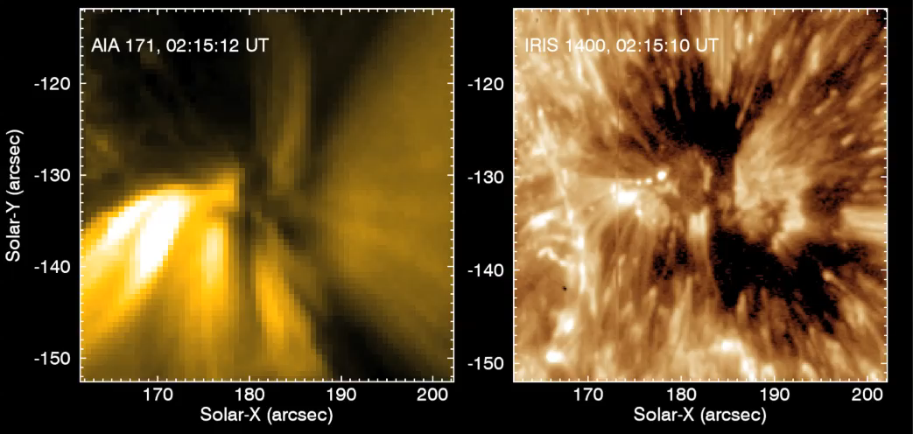
Transition region imaging
IRIS is first spacecraft with a transition region filtergraph (SJI 1400 Å)
Shows Si IV λ1393, λ1402 (80,000 K)
AIA, IRIS sunspot observation
3-Oct-2015

Slide 6
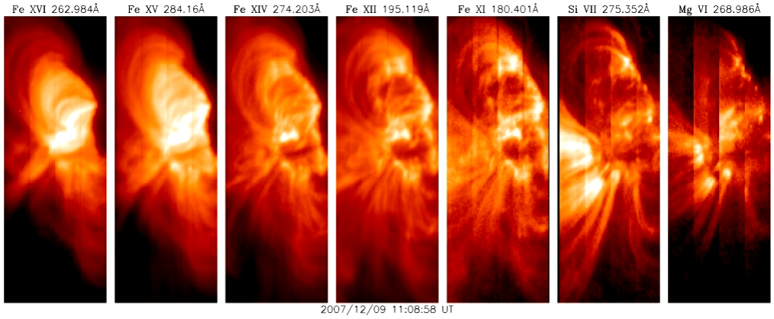
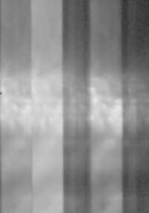
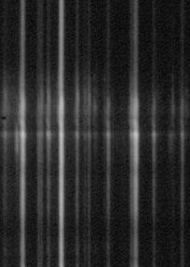
Transition region imaging
Spectrometer wide slit (slot) mode allows monochromatic imaging in narrow spatial region
Slot rastering allows larger images
Ugarte-Urra et al. (2009, ApJ)
SPICE imaging will enable heating to be traced from chromosphere to corona
SPICE Ne VIII images will look like this
SPICE O VI images will look like this

Slide 7
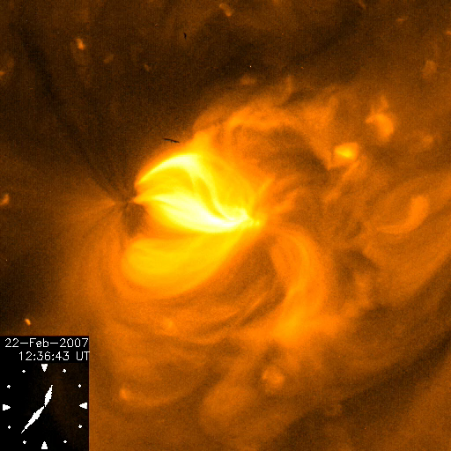
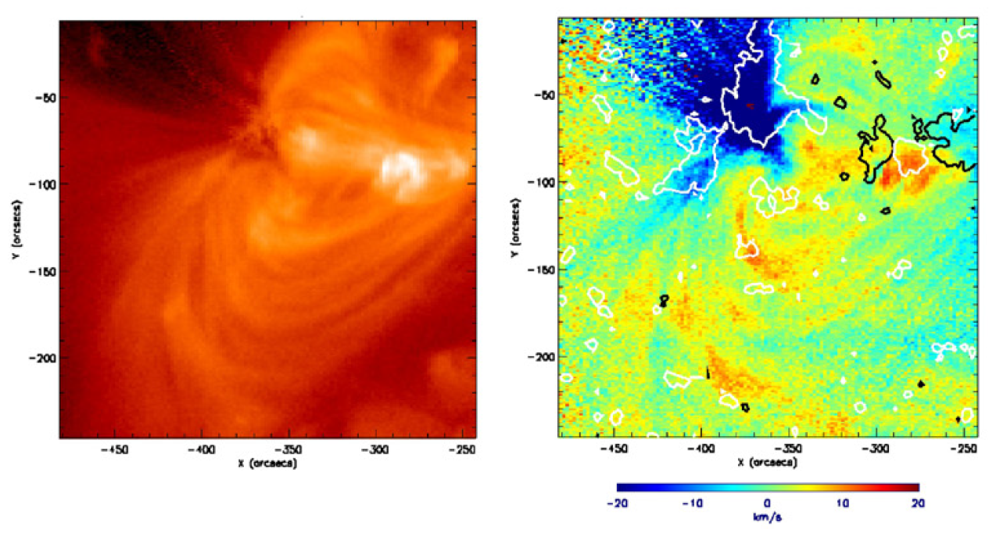
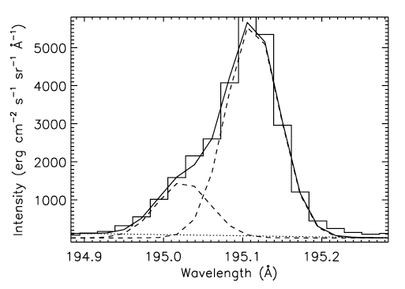
Active region outflows
All active regions show persistent outflow patches (blue) in coronal spectral lines (Fe X-XVI) of 10-20 km/s
The patches also show repeating high velocity (100 km/s) jets
Will SPICE see the outflows?
Best lines are Si XII λ499, λ520 [2nd order]
Ne VIII is too cool
Sakao et al. (2007, Science)
High velocity blue “bump”
Baker et al. (2009, ApJ)

Slide 8
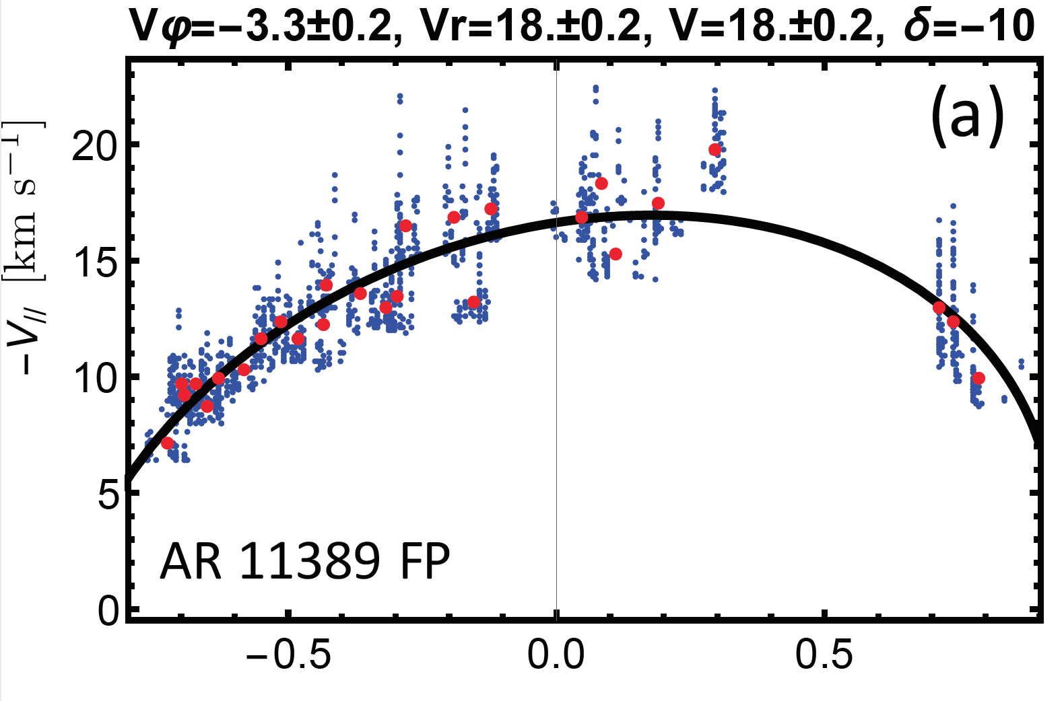
AR outflows - what do we know?
What is cause?
Most popular: interchange reconnection [Del Zanna et al. (2011, A&A)]
Also: hot spicules [McIntosh & De Pontieu (2009, ApJL)]
Source of slow solar wind?
Yes (sometimes) [Van Driel.-Gesztelyi. et al. (2012, Sol. Phys.)]
May require 2-step process [Culhane et al. (2014, Sol. Phys.)]
What will Solar Orbiter give?
Flows are seen in all ARs, all of the time [Baker et al. (2017, arXiv)]
Closer connection to source region
Full-disk magnetograms for extrapolation
Opportunity for SolO+SPP joint science
➡ see Deb Baker’s talk (Wed)

Slide 9
Element abundances & FIP effect
Resurgence of interest in coronal abundance measurements (EIS)
Main ratio is silicon-to-sulphur (1.5 MK)
 | Region | Cit
Hahn et al. (2010, ApJ) | CH | 8
Brooks & Warren (2011, ApJL) | AR outflow | 54
Brooks & Warren (2012, ApJ) | AR outflow | 18
Baker et al. (2013, ApJ) | AR | 11
Culhane et al. (2014, ApJ) | AR outflow | 17
Brooks et al. (2015, Nat. Comm.) | Full Sun | 13
Baker et al. (2015, ApJ) | AR | 8
Guennou et al. (2015, ApJ) | CH plumes | 2
K.-S. Lee et al. (2015, ApJ) | Jets | 4
Doschek et al. (2015, ApJL) | Flare | 6
Doschek et al. (2016, ApJ) | Flare | 1
Ko et al. (2016, ApJ) | AR | -
Warren et al. (2016, ApJ) | AR | 1
Key results
FIP bias=3-4 for AR outflow regions
AR FIP bias decreases with time
Inverse FIP effect in some flares

Slide 10
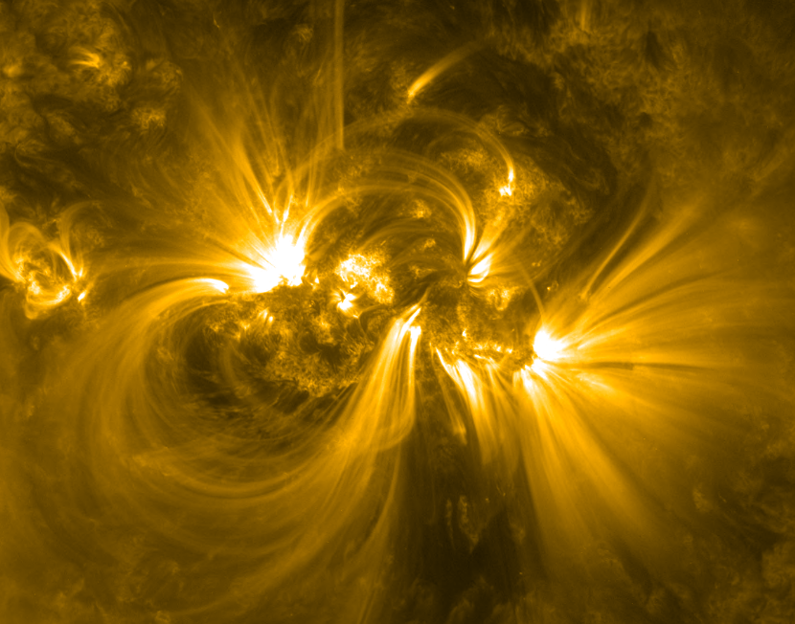
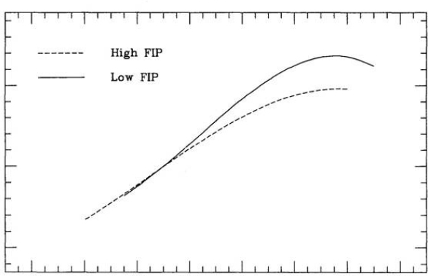
Element abundances
Mg/Ne FIP bias at 0.7 MK is the key measurement for SPICE [Mg VIII/Ne VIII]
What can we expect?
fan loops will show high FIP bias (4-10)
good ratio for coronal holes & plumes
will quiet Sun show FIP bias?
AIA 171
Fan loops
50
Log ( EM / cm⁻⁵ )
49
➡ see Alessandra Giunta’s talk
Quiet Sun
Laming et al. (1995)
48
5.4
5.8
6.2
Log ( Temperature / K )

Slide 11
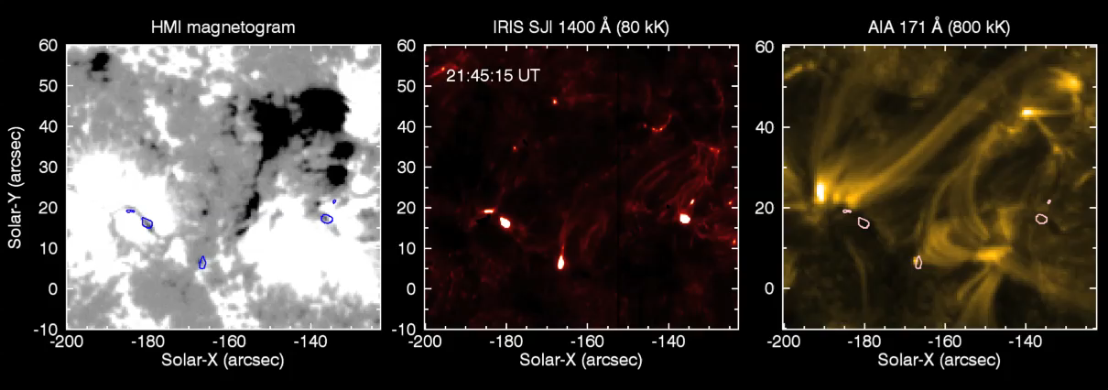
UV bursts in active regions
Intense brightenings in the transition region (IRIS; Si IV)
Fundamental reconnection event
Precursors to flares and eruptions?
[J. Zhang & J. Wang (2002, ApJ)]

Slide 12
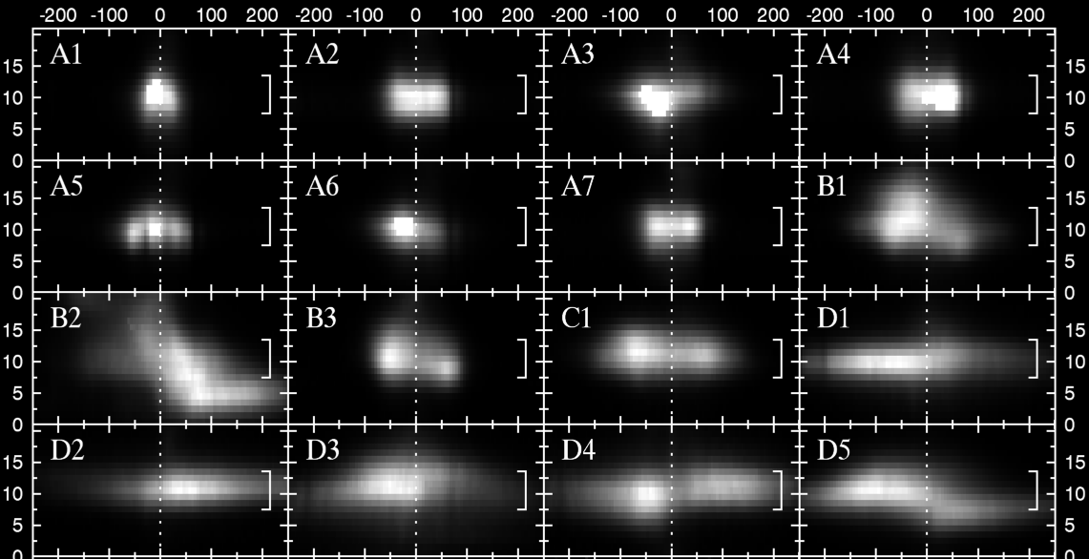
UV bursts in active regions
What can SPICE & SolO do?
What is max temperature of events? [O IV-VI, Ne VIII]
How high is the density? [O V, Ne VI diagnostics]
Statistics for SEE-productive regions [using slot images]
Magnetic topology [PHI magnetograms]
Chromosphere/coronal imaging [EUI]
Solar-Y / arcsec
A zoo of line profiles
- are they telling us about the reconnection site?
Velocity / km s⁻¹

Slide 13
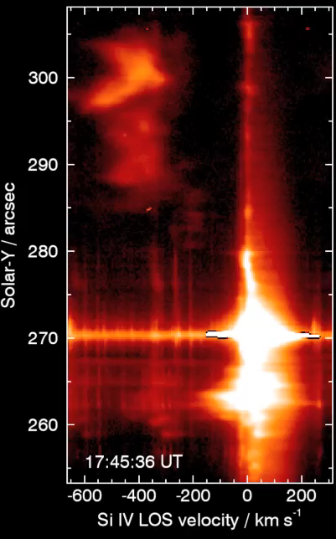
Eruptive events
Spectrometers bring an extra dimension to eruption studies
Example 1: IRIS, 29-Mar-2014 X-flare [Kleint et al. 2015, ApJ]
Filament ejecta tracked in transverse and longitudinal directions
speeds up to 600 km s⁻¹ @ 40 Mm from flare site
acceleration: 3-5 km s⁻² (high!)

Slide 14
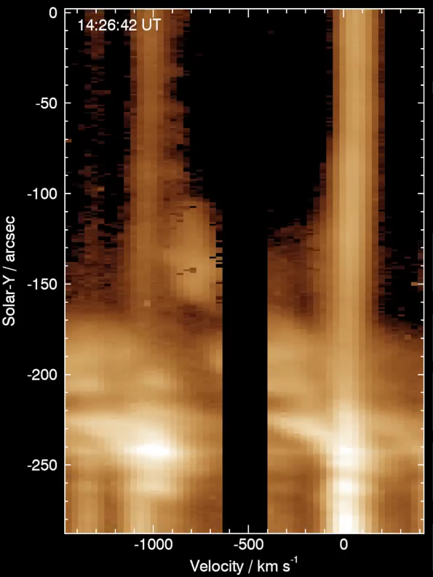
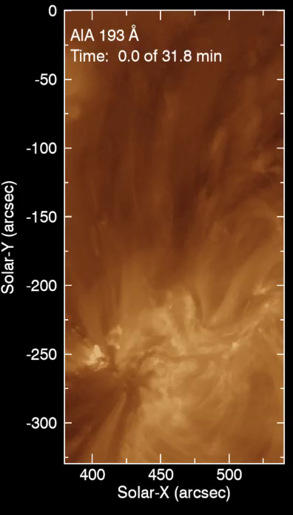
Eruptive events
Fe XI
1.4 MK
Fe XII
1.6 MK
Example 2: EIS, 16-Feb-2011 M-flare [Harra et al. 2011, ApJ; Veronig et al. 2011, ApJL]
800 km/s
SPICE operations issues
Make sure wavelength windows are big enough!

Slide 15

Hot lines in the UV
Atomic levels for hot Fe ions
~ 100 eV
~ 10 eV
Emission lines
in X-rays
Emission lines
in ultraviolet

Slide 16
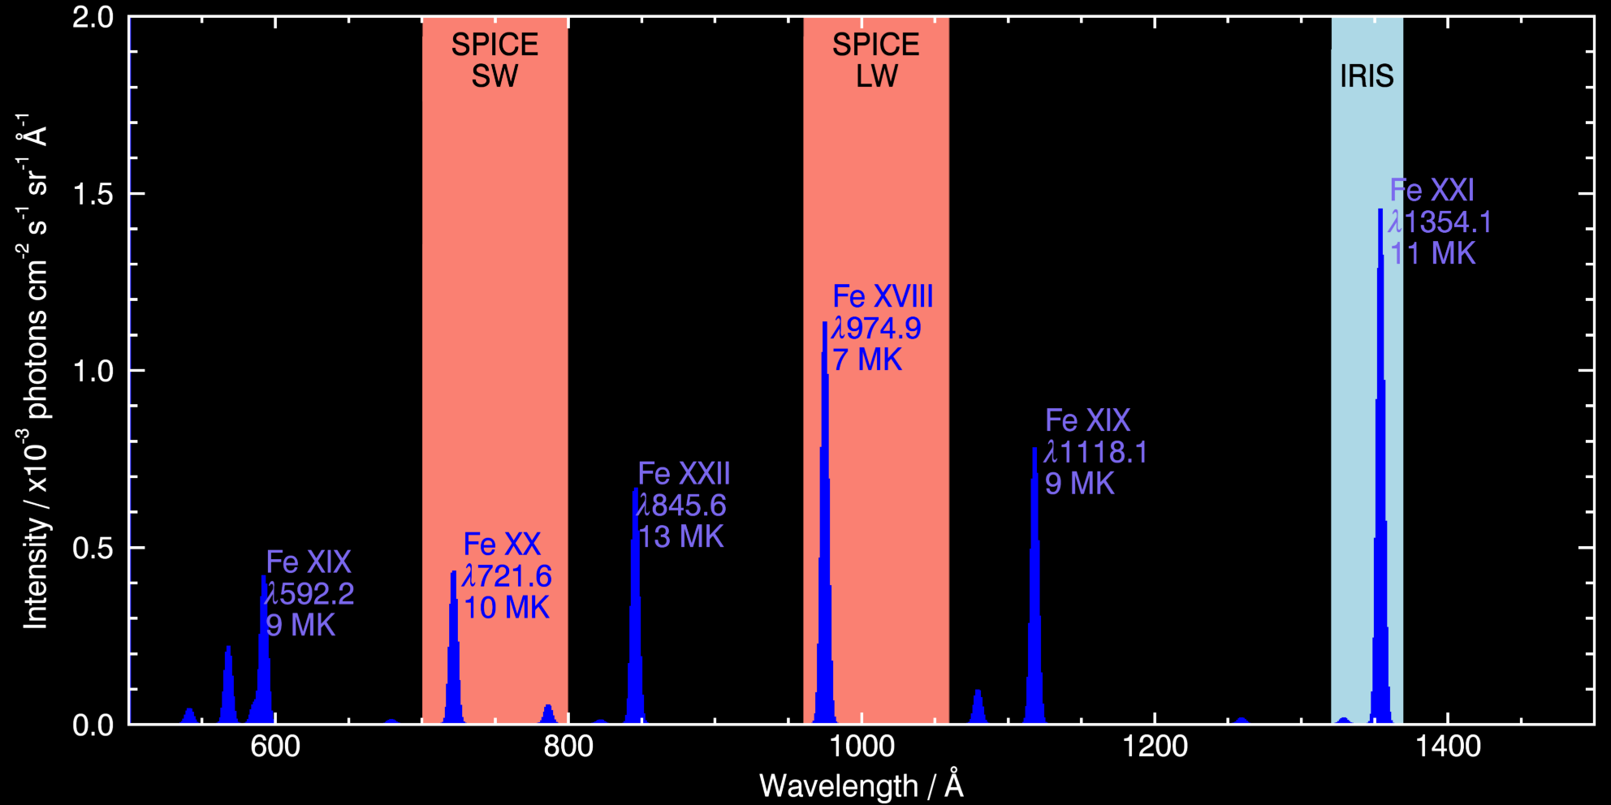
Hot lines in the UV

Slide 17
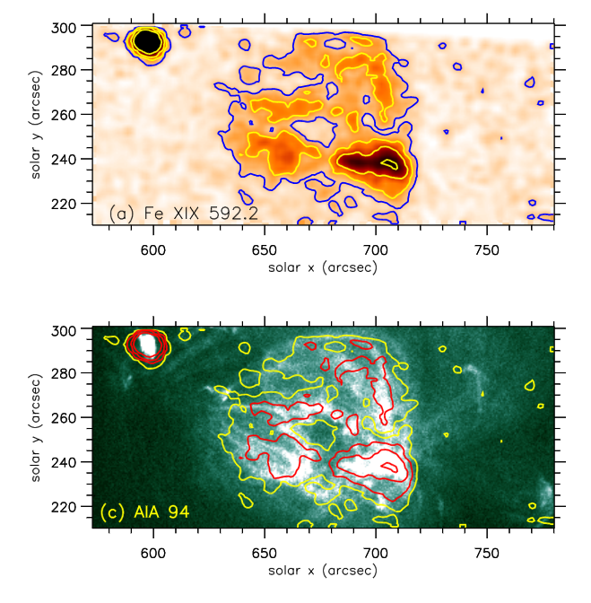
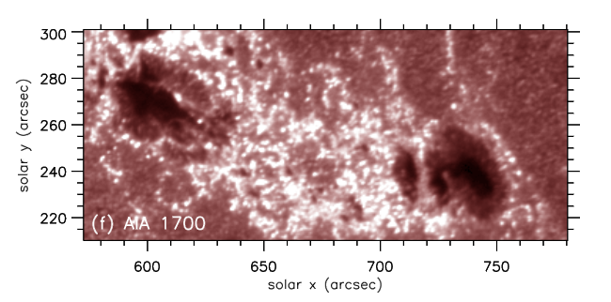
Nanoflares
Active regions typically 3-4 MK
If heated by nanoflares, expect 5-10 MK plasma
Fe XIX and Fe XX are considered ideal ions for detecting nanoflares
The EUNIS rocket found a weak haze of Fe XIX (9 MK) emission in an active region
➡ SPICE will observe Fe XX λ721.56
Brosius et al. (2014, ApJ)

Slide 18
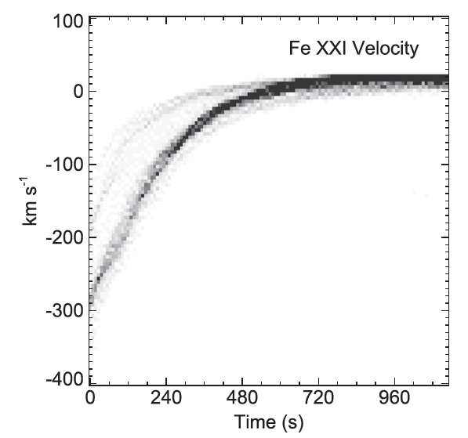
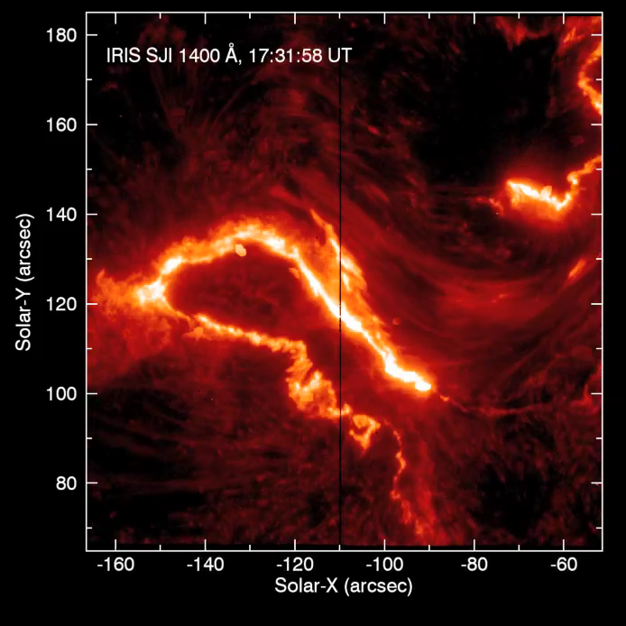
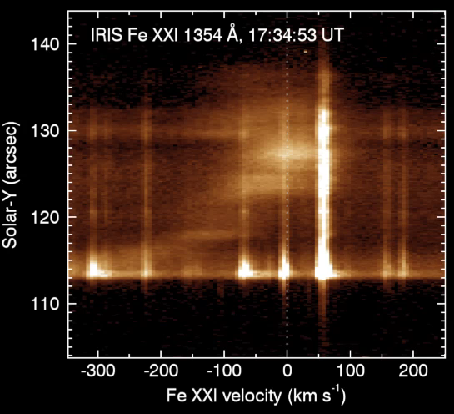
Flares
Hot plasma is “evaporated” from flare ribbons at speeds 100 to 400 km s⁻¹
Beautifully observed in IRIS Fe XXI line
Graham & Cauzzi (2015, ApJL)
SPICE lines will not be affected by chromospheric lines; but will see continuum
10-Sep-2014 X-flare

Slide 19
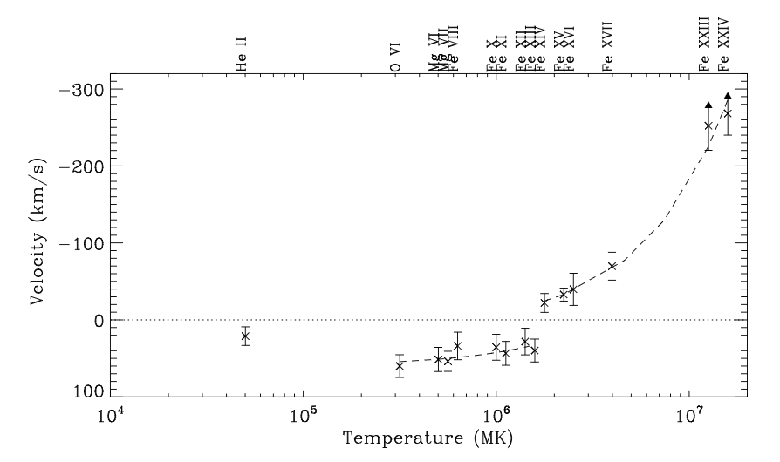


Chromospheric evaporation
SPICE enables velocities to be measured from chromosphere to corona
SPICE operations issues
Care has to be taken with saturation
transition region becomes very intense
exposure control necessary
Sit-and-stare observations highly recommended
Detailed evaporation/condensation profile from EIS
(Milligan & Dennis 2009, ApJ)

Slide 20
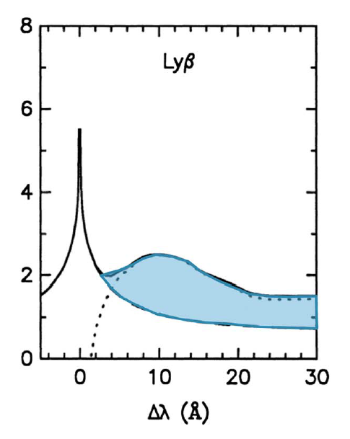


Proton beam heating in flares
SPICE may see evidence for proton beam heating during flares, with hydrogen Lyman-β 1025 Å
Unique access to sub-MeV proton beam energies
Suitable for low-rate “filler” study?
protons
redshifted H emission
Holman (2016, JGR)
[adapted from Fang et al. (1995, A&A)]
charge exchange

Slide 21
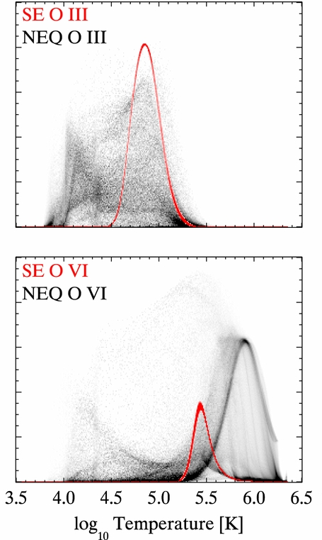
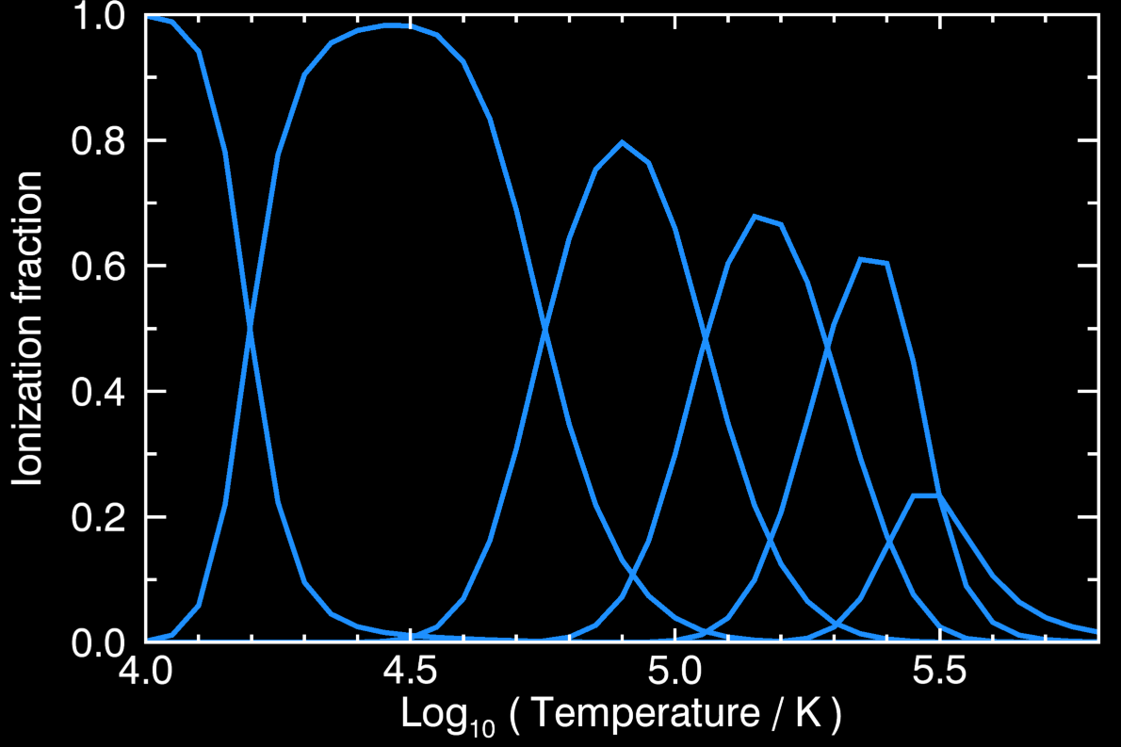
Studies of non-equilibrium ionization
SPICE will see a continuous sequence of oxygen ions from the chromosphere to upper transition region
Ideal testing ground for non-equilibrium codes (e.g., Bifrost)
Ion | Wavel/Å | Temp/kK
O I | 1027.44 | 10
O II | 718.50 | 30
O III | 703.85 | 80
O IV | 790.20 | 140
O V | 760.45 | 220
O VI | 1031.91 | 280
Olluri et al. (2013, ApJ)

Slide 22
Recap
Temperature coverage - most complete of any spectrometer
Temperature coverage! - high cadence movies from c/s to corona
Temperature coverage!! - sequence of oxygen ions
Links to solar wind:
FIP bias diagnostic (Mg/Ne)
AR outflow regions
Excellent flare/nanoflare diagnostics (Fe XVIII, XX)

