Slide 1
Using flare data to calibrate the Hinode/EIS instrument and derive element abundances
Dr. Peter R. Young
NASA GSFC & Northumbria University, UK
Dr. Biswajit Mondal
University of Alabama in Huntsville & NASA MSFC

Slide 2
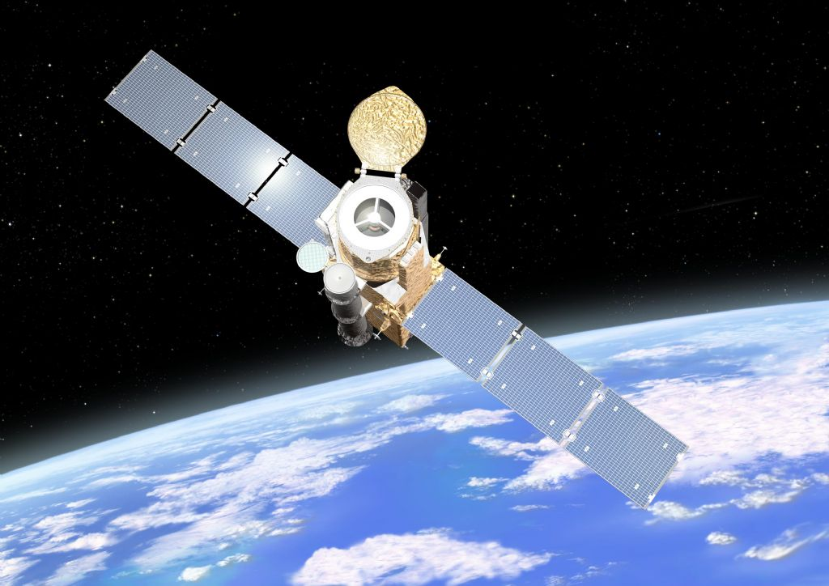
Hinode (Solar-B)
Launched in Sep 2006
Three instruments:
  Solar Optical Telescope (SOT)
  X-ray Telescope (XRT)
  EUV Imaging Spectrometer (EIS)
Mission goal:
  Study the connections between fine magnetic field elements in the photosphere and the structure and dynamics of the entire solar atmosphere.

Slide 3
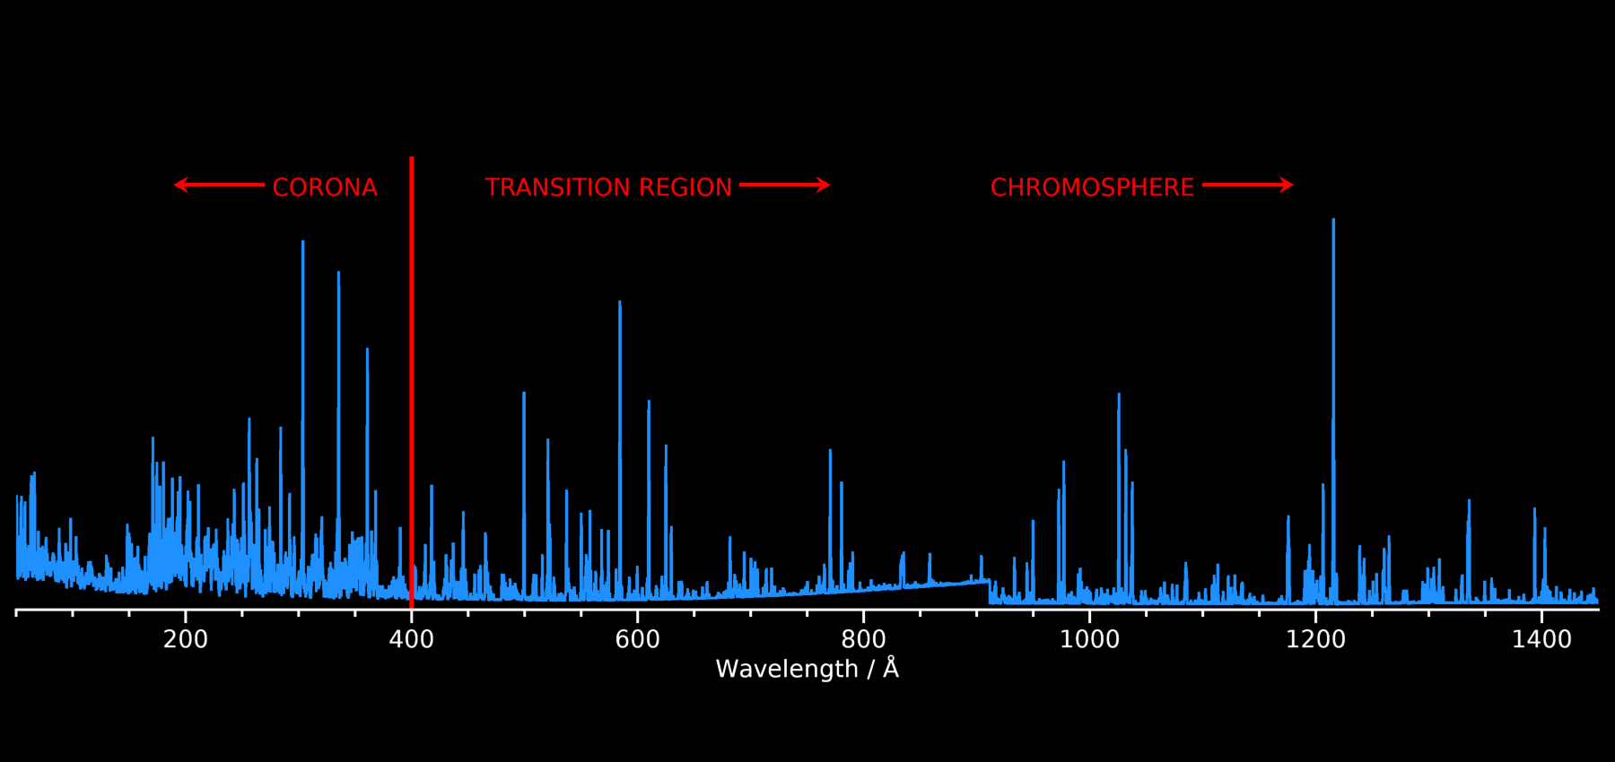
The EUV is the best region for studying the solar atmosphere
EUV contains thousands of emission lines, diagnosing the transition region and corona

Slide 4
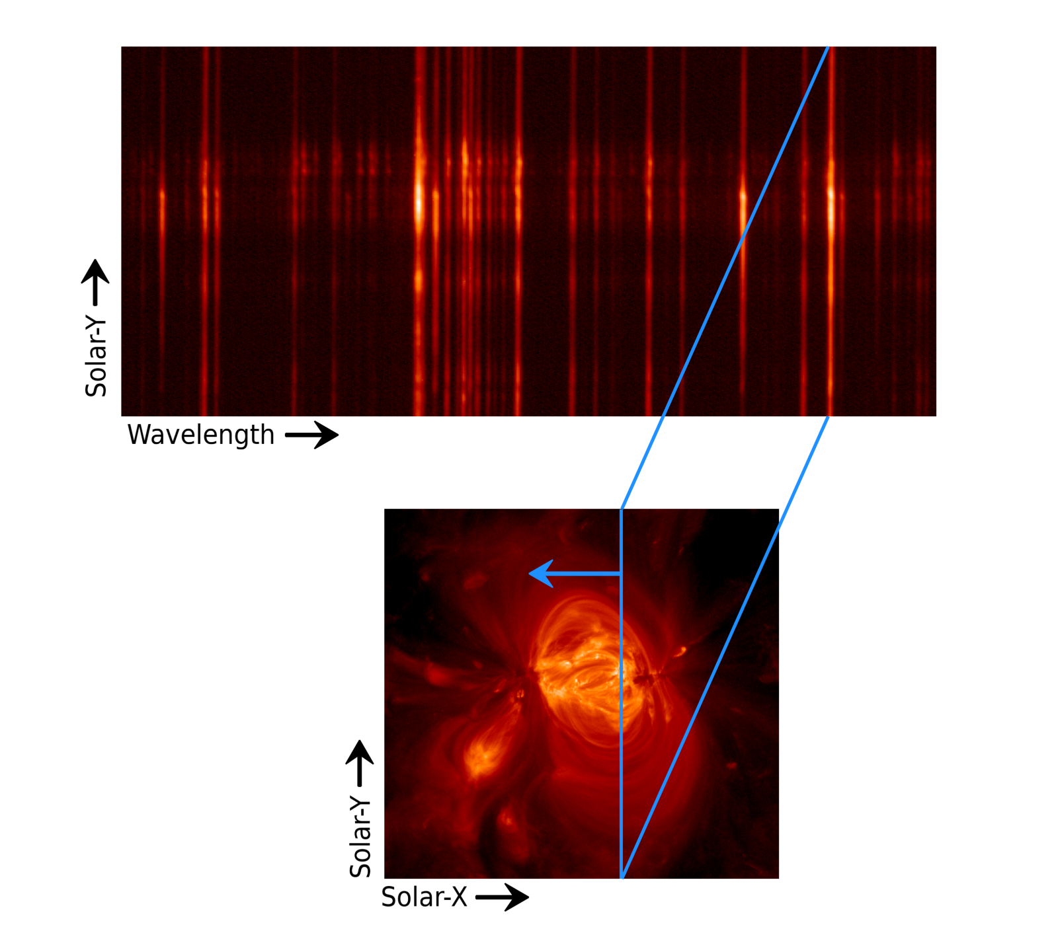
EIS: a scanning slit spectrometer
Two wavelength bands
  171-212 Å and 246-292 Å
Spatial resolution: 3 arcsec
Images built up by rastering
Innovation: first spacecraft EUV spectrometer to use multilayer coatings

Slide 5
Multilayer coatings
Standard optical surface coatings do not reflect EUV radiation.
Early EUV instruments used grazing incidence optics.
Multilayer coatings consist of alternating layers of a light and heavy element (e.g., Mo and Si).
Used for solar observations in the 1980’s (Underwood et al. 1987).
Began the EUV imaging revolution!

Slide 6
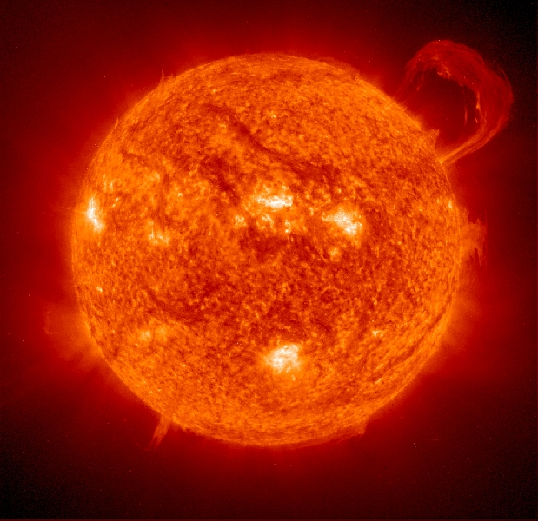
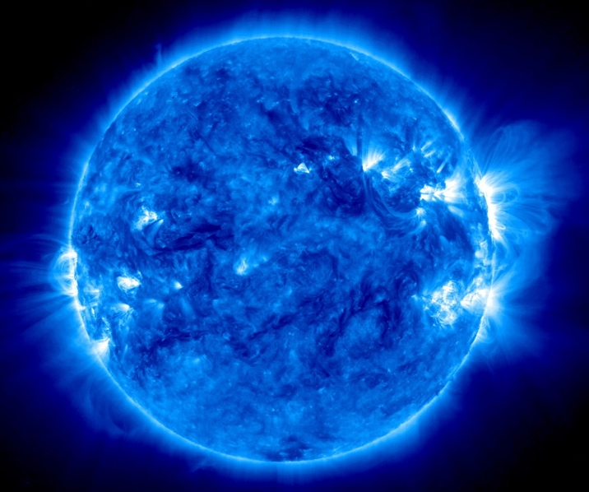
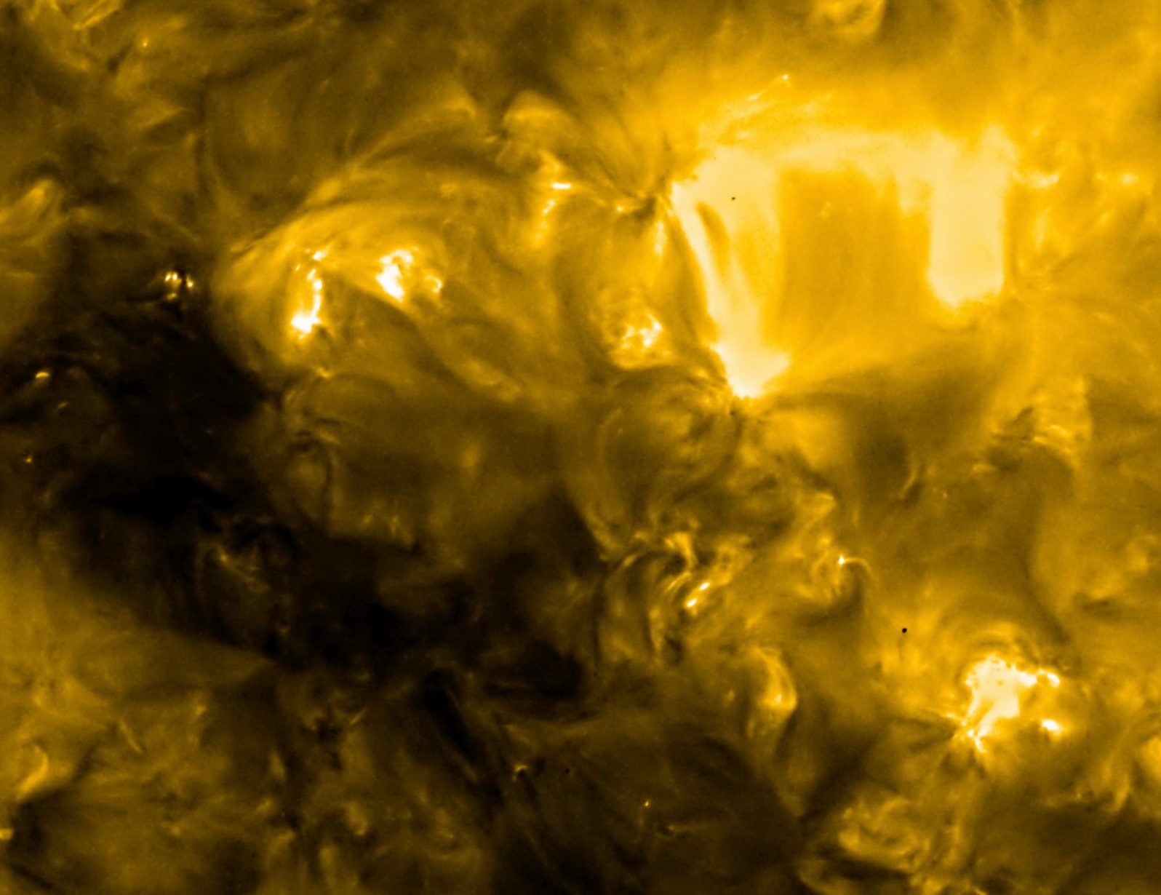
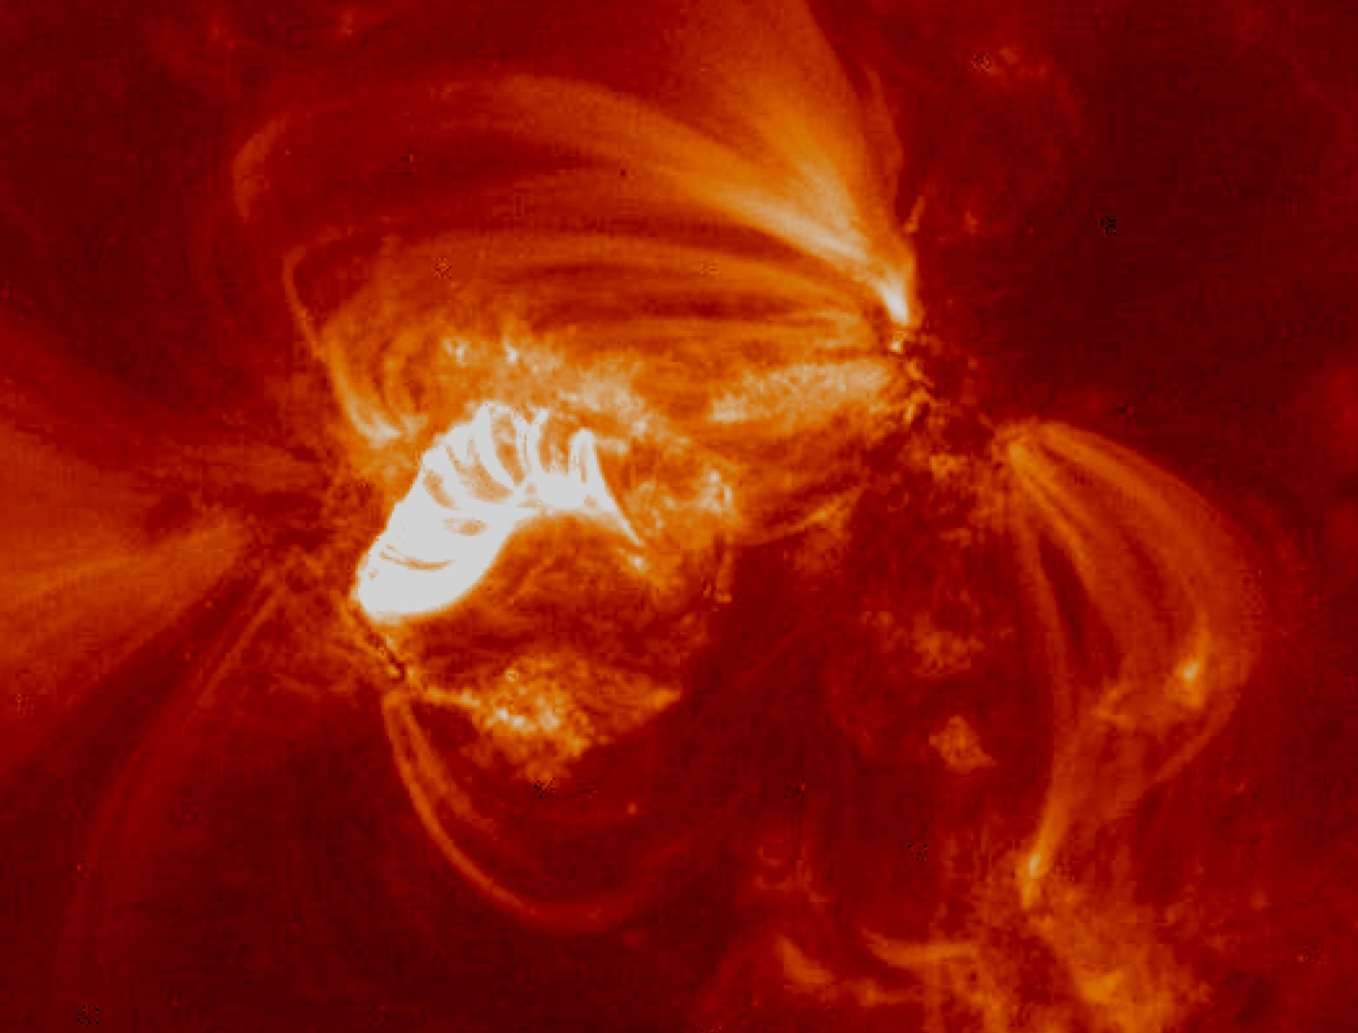
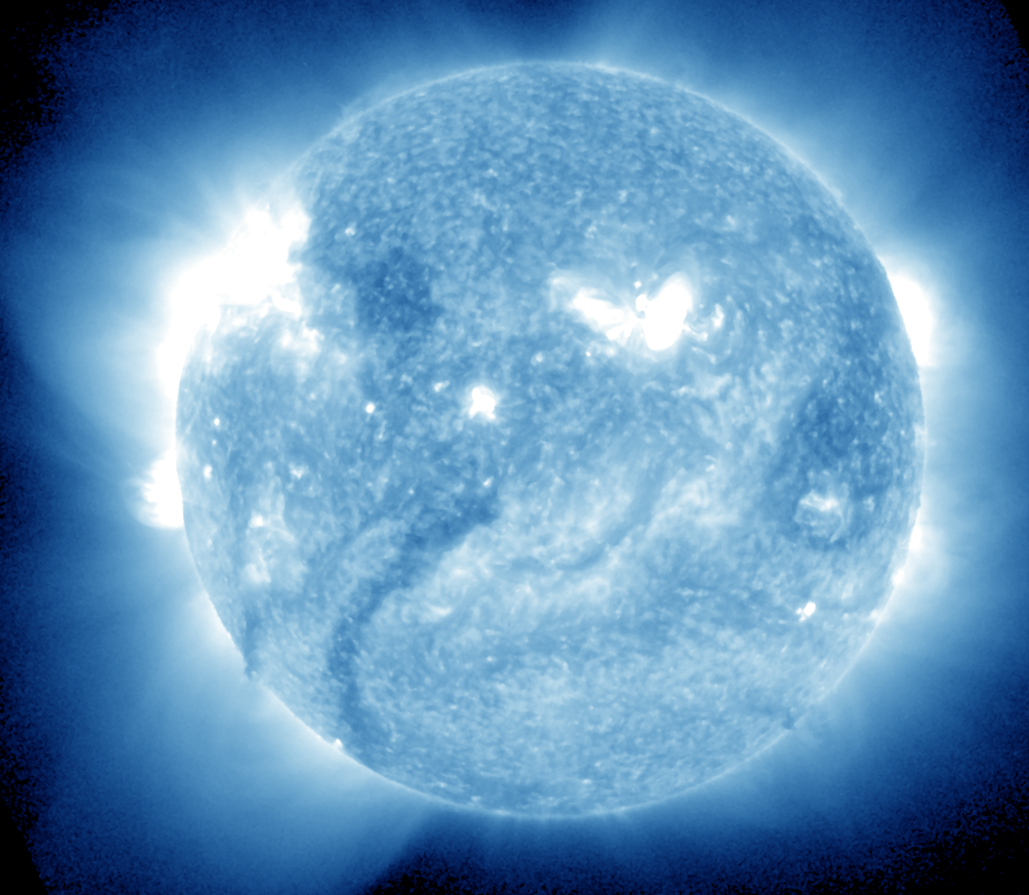
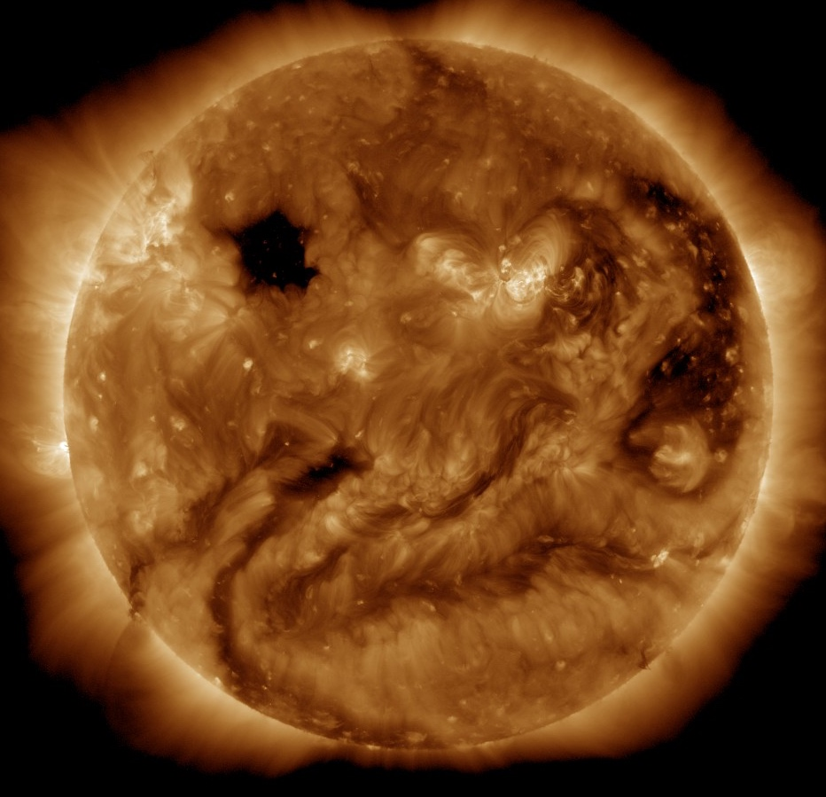
SOHO/EIT (1996)
STEREO/EUVI (2006)
Solar Orbiter/EUI (2020)
TRACE (1998)
GOES/SUVI (2018)
SDO/AIA (2010)

Slide 7
Multilayer coatings
Multilayer coating enhances reflectivity only over a narrow wavelength band.
Coating can be “tuned” to specific spectral features.

Slide 8
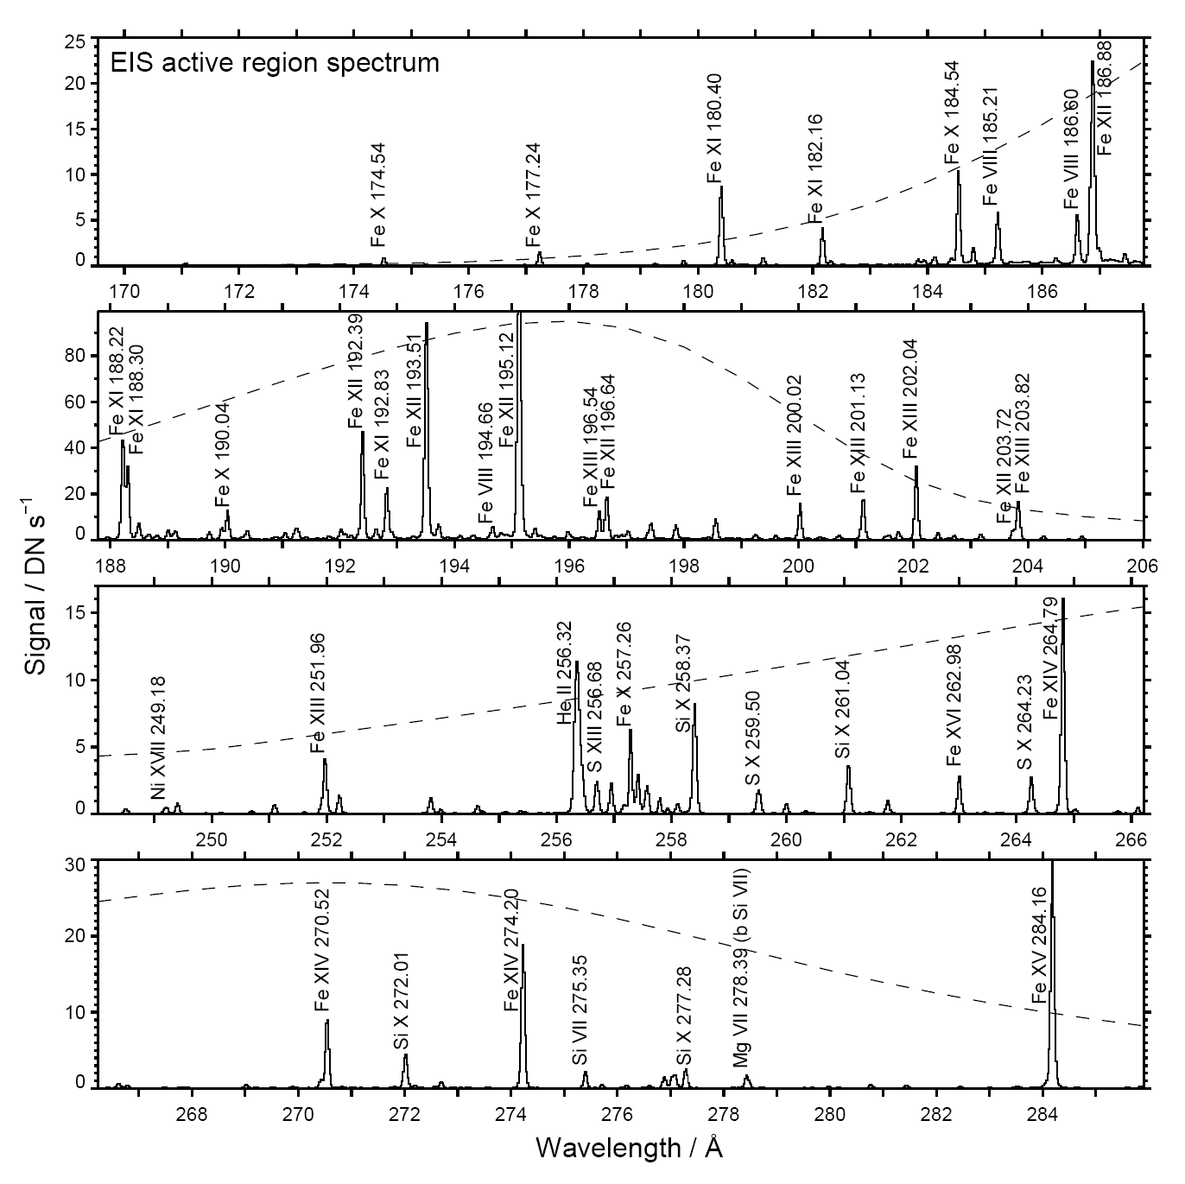
EIS multilayers
EIS uses two multilayer coatings (applied to mirror and grating) for the two wavelength bands.
Sensitivity varies with wavelength, particularly for short wavelength band.

Slide 9
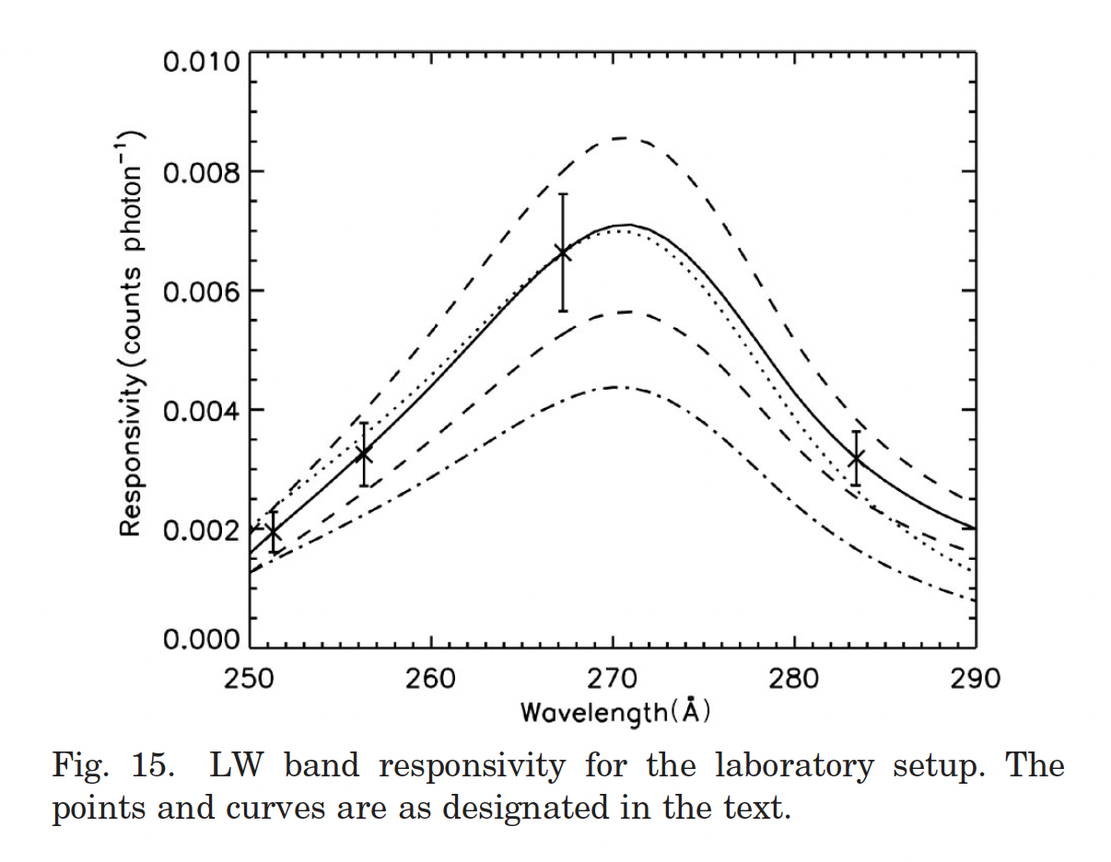
Calibrating an EUV spectrometer
Pre-launch: perform end-to-end calibration in lab.
Perform regular checks in orbit:
  Compare with other spacecraft instruments (e.g., EVE, AIA).
  Cross-calibrate with rocket spectrometer (e.g., EUNIS).
  Self-calibrate using EIS spectra.
Pre-launch calibration
(Lang et al. 2006)

Slide 10
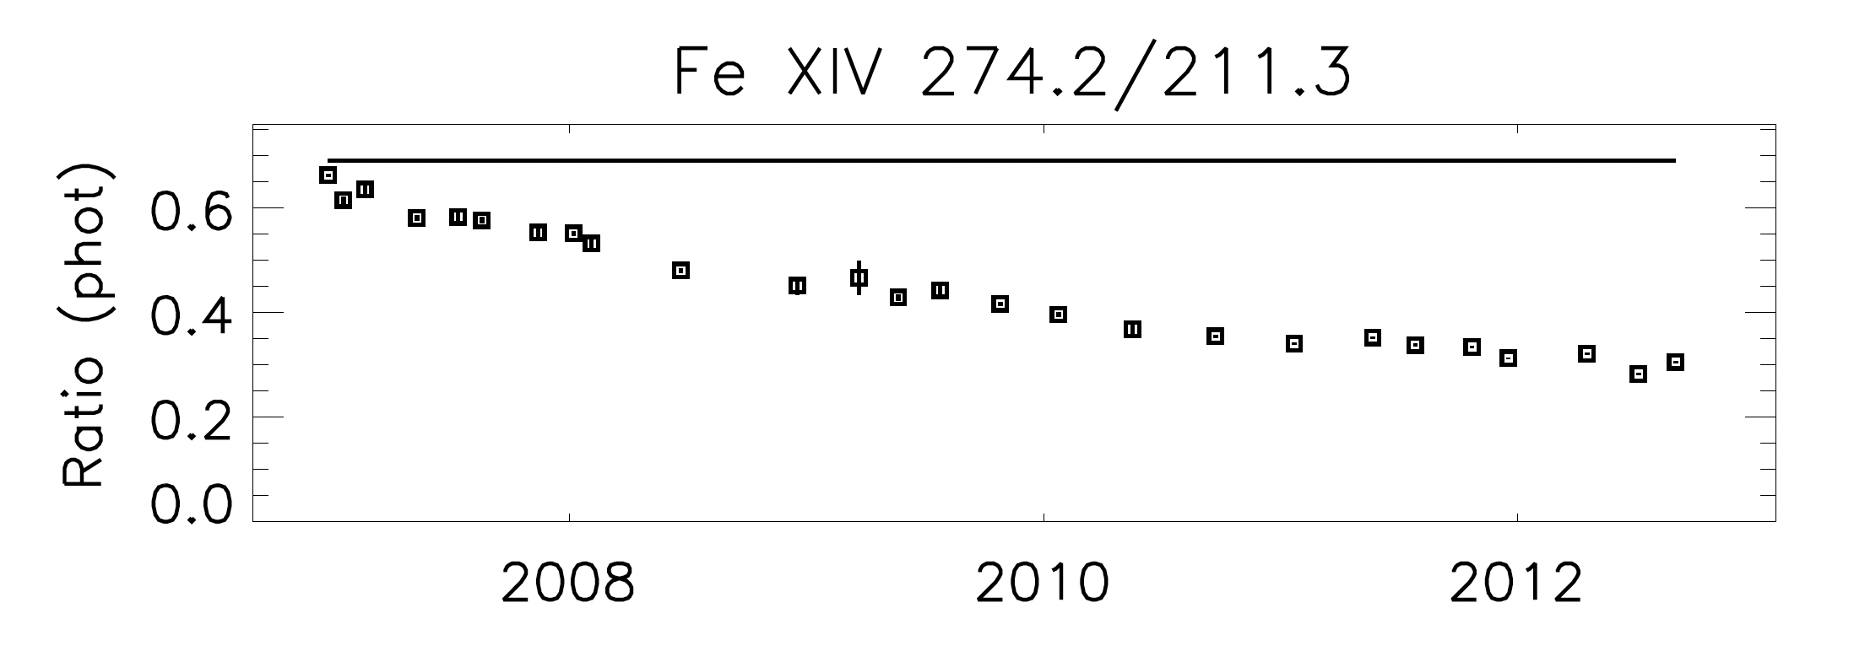
Self-calibrating EIS
Some emission line ratios are insensitive to plasma conditions.
  Allow degradation to be tracked with time.
  Check if the shape of the effective area curves are changing.
Quiet Sun intensities are constant over solar cycle (“standard candle”).
Quiet Sun at limb is almost isothermal.
Del Zanna (2013)

Slide 11
EIS calibration history
Lang et al. (2006) pre-launch calibration.
T. Wang et al. (2011) cross-calibrated against 2007 EUNIS flight.
Mariska (2013) found exponential decay with time.
Del Zanna (2013) found LW channel decayed faster than SW channel.
Warren et al. (2014) confirmed this result and obtained absolute calibration using SDO/EVE.
Del Zanna et al. (2025): definitive new calibration over 2007-2022 period.

Slide 12
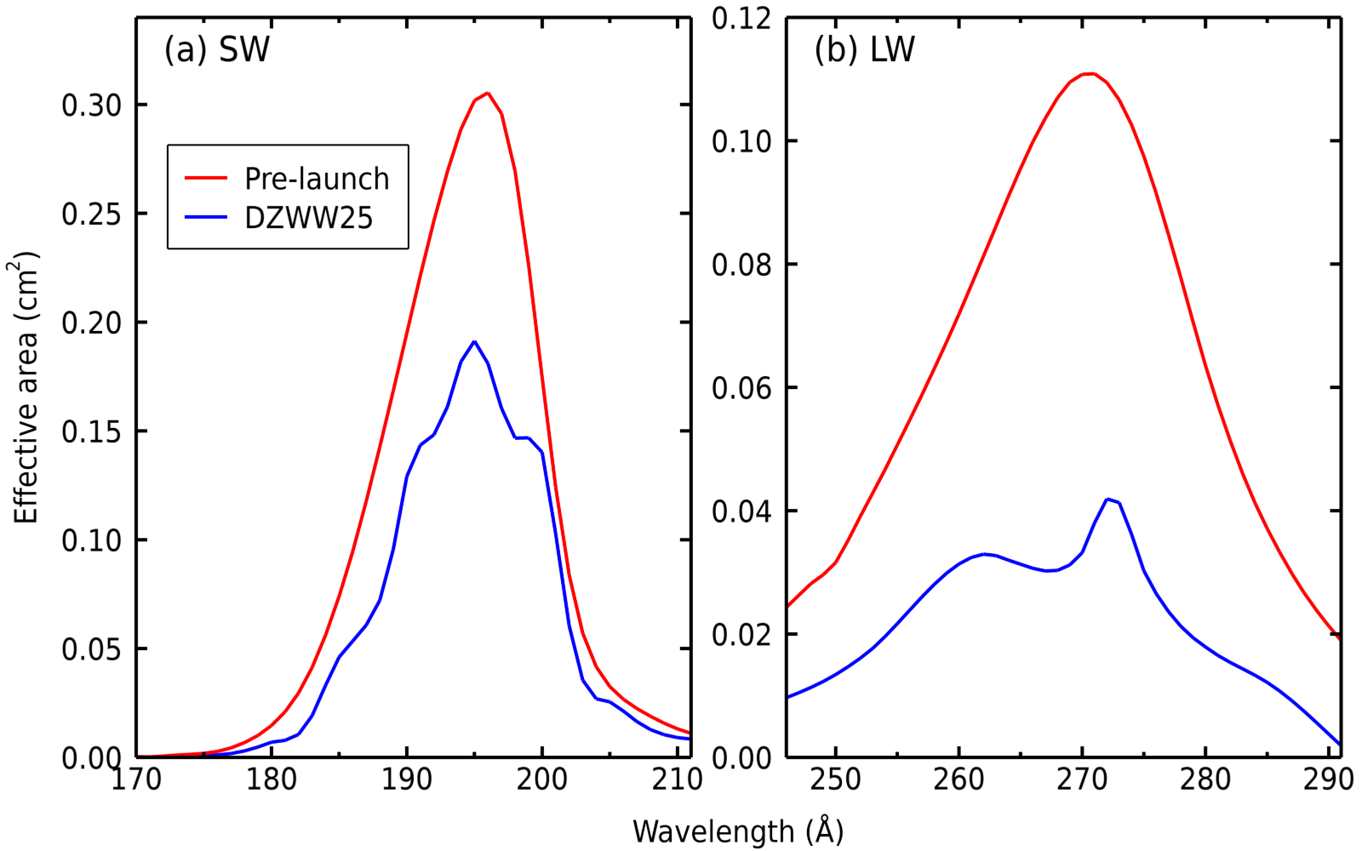
EIS calibration comparison
“bumps-and-wiggles”
DZWW25 curves for 1-Jan-2022

Slide 13
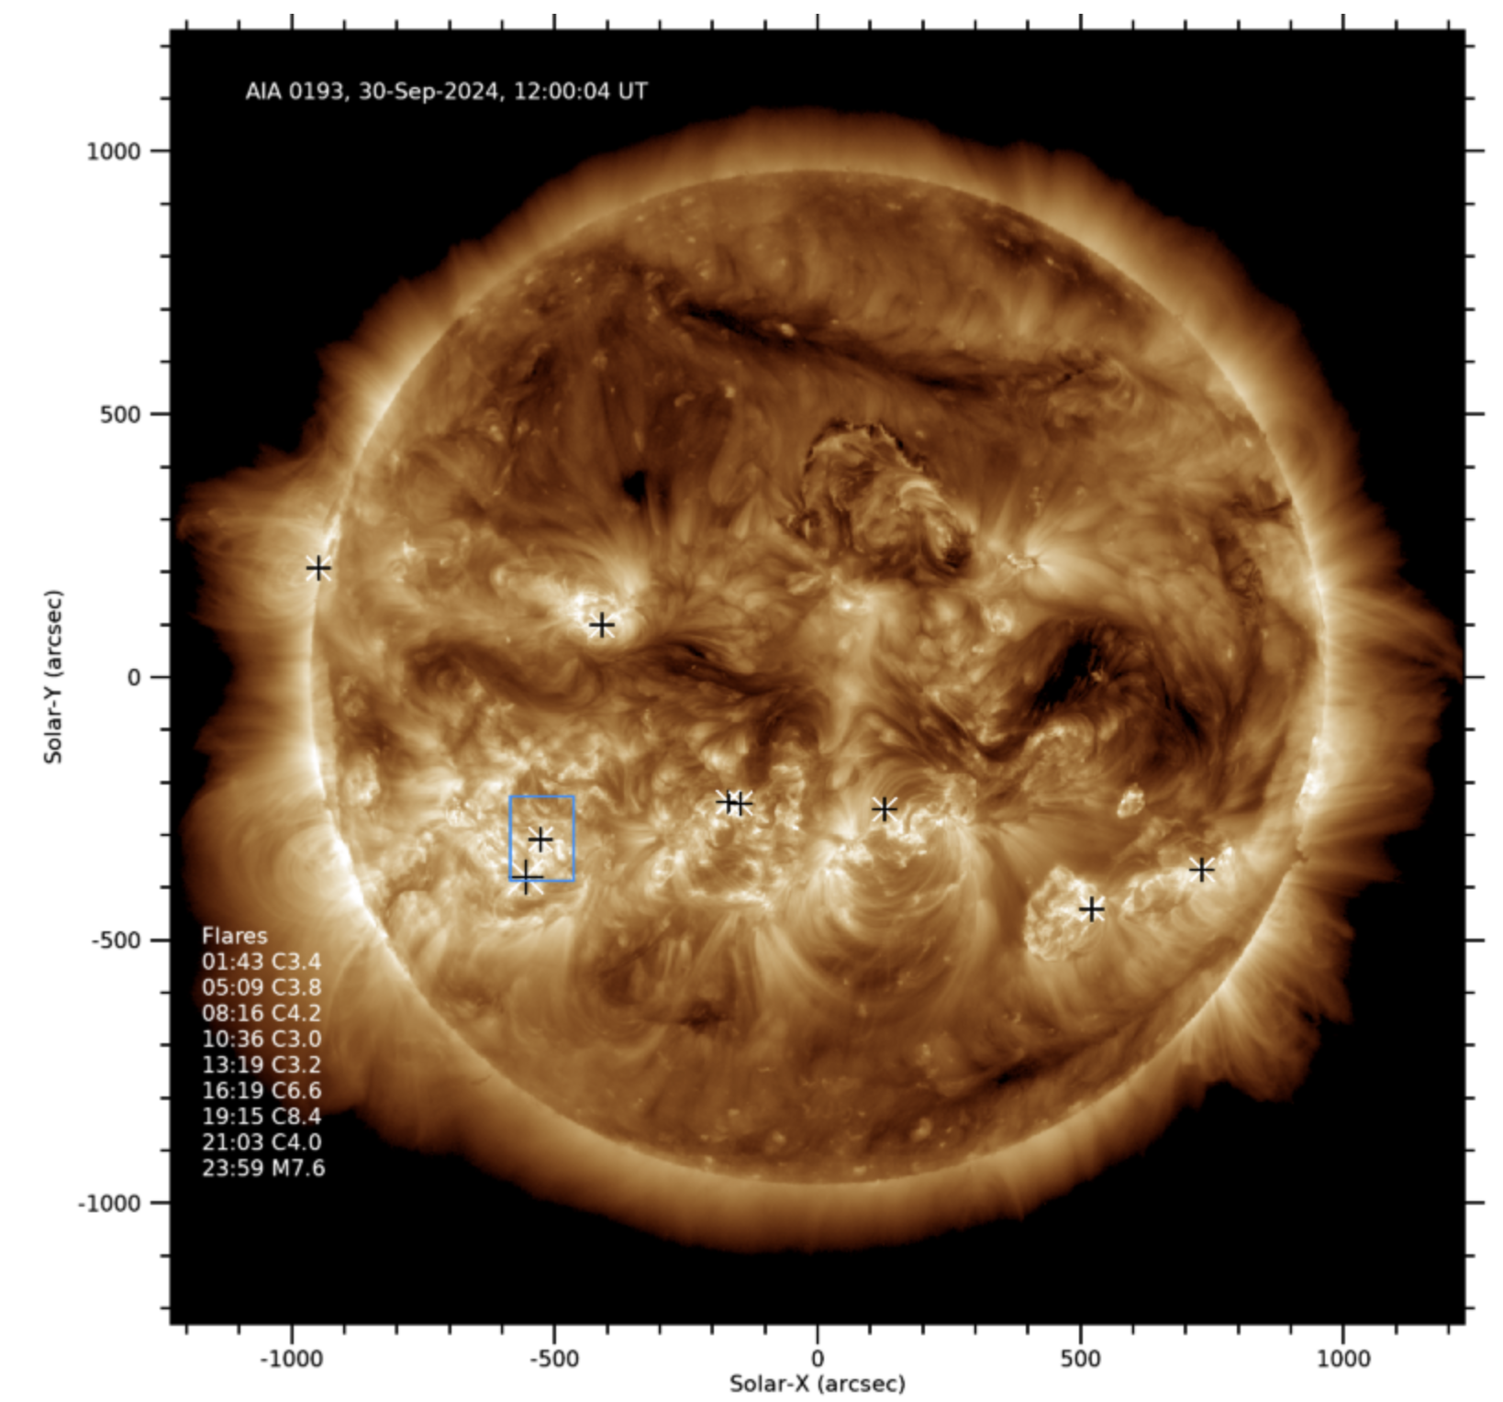
Stroke of luck!
EIS caught a big flare with a long-duration “spectral atlas” study.
M8 flare on 30-Sep-2024.

Slide 14
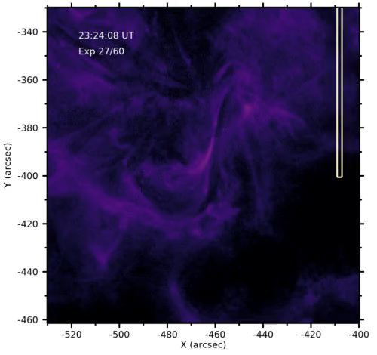
Context movie: AIA 131 Å

Slide 15
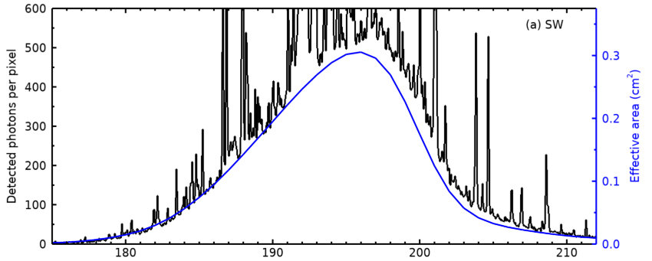
Flare continuum is very strong
Shape of continuum curve quite similar to pre-launch effective area curve

Slide 16
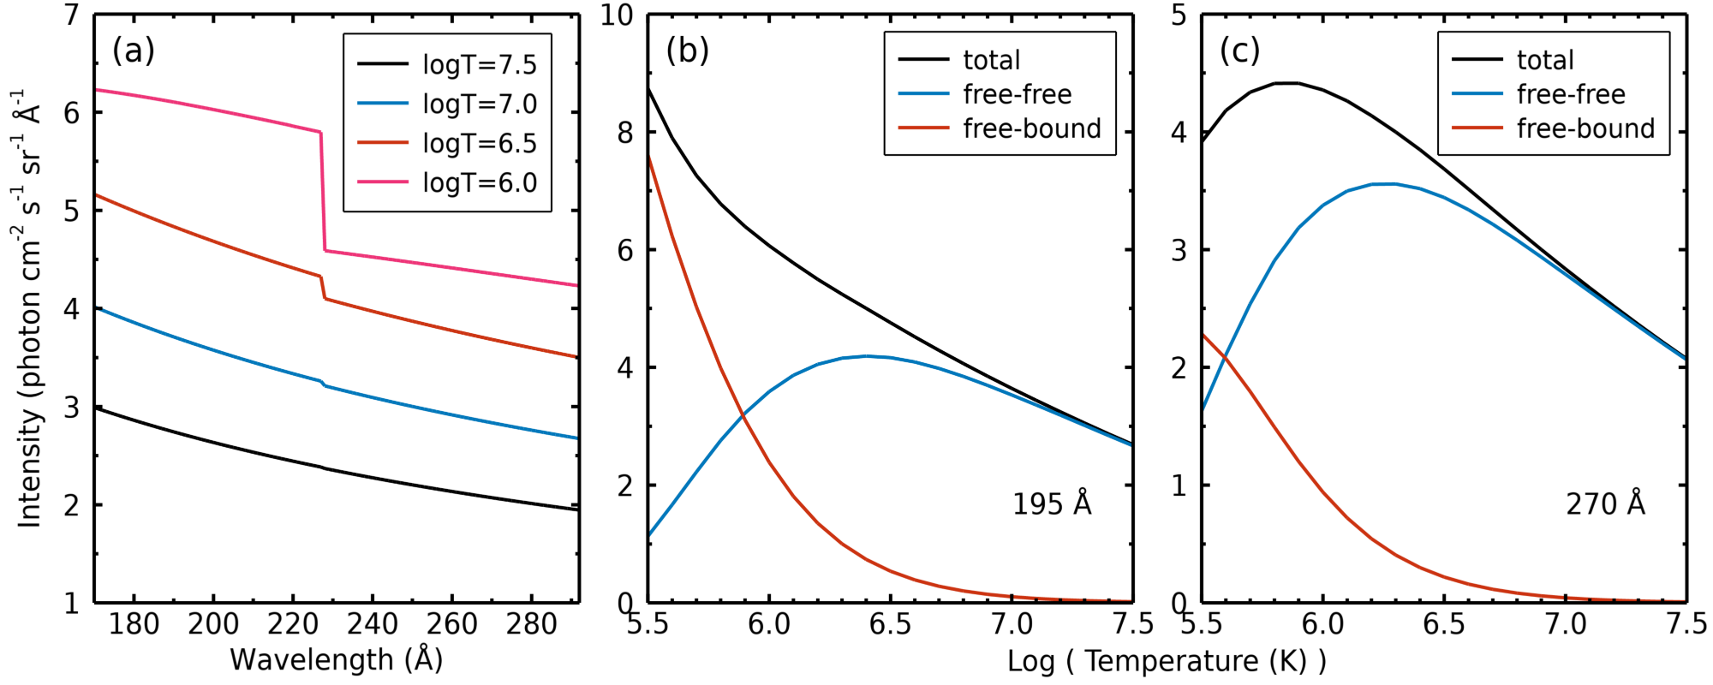
What should continuum look like?
Curves calculated with CHIANTI software (ch_continuum).
At flare temperatures (10 MK), continuum dominated by free-free (bremsstrahlung).
Need to know temperature structure to model continuum.

Slide 17
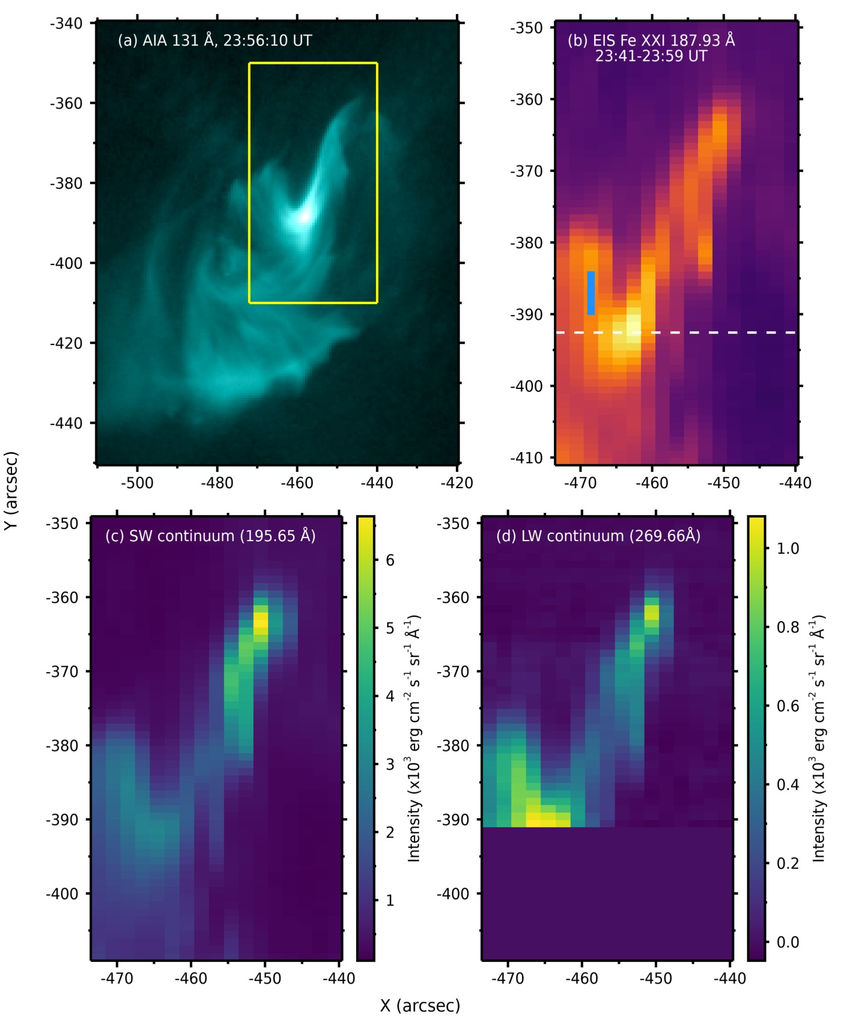
Study continuum from here
Right footpoint is brighter in SW continuum
Free-bound continuum is significant (strong transition region emission)

Slide 18
Procedure
Measure continuum intensities from the photon spectrum at sets of wavelengths across both wavelength channels.
Measure a set of emission line intensities from the LW calibrated spectrum.
Perform a DEM analysis using the LW emission line intensities.
From the DEM, create a model for the continuum emission in both the SW and LW channels.
Derive updated SW and LW effective area curves by comparing the continuum intensities with the continuum model.
With the modified effective area curves, adjust the LW emission linem intensities, and repeat steps (3) to (5).

Slide 19
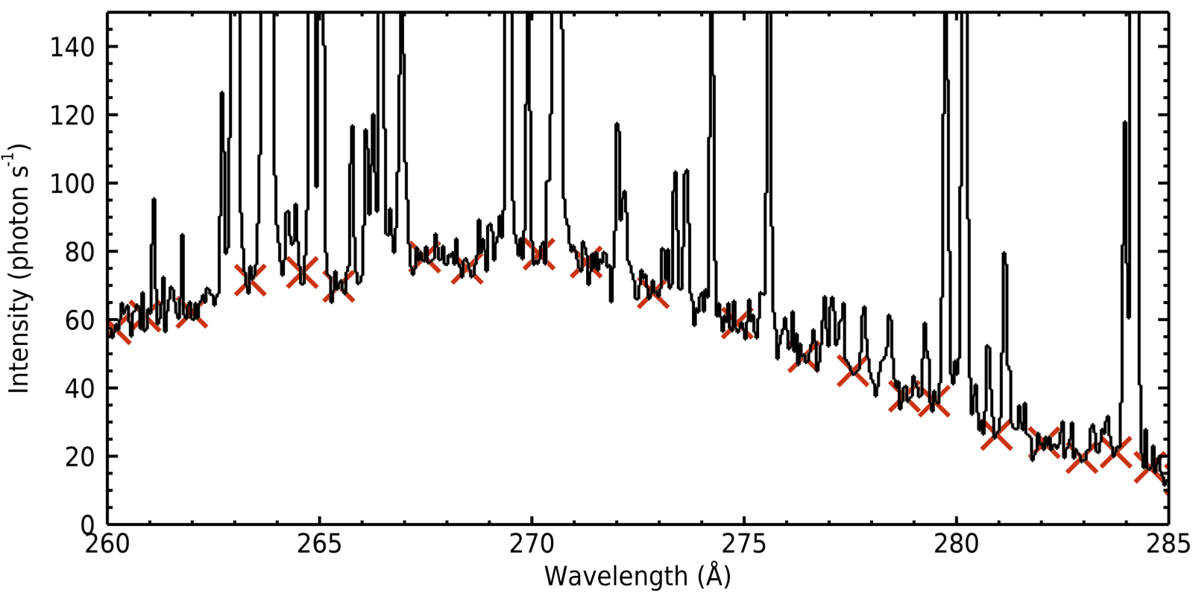
Step 1a: continuum measurement
Choose local minima in the spectra.

Slide 20
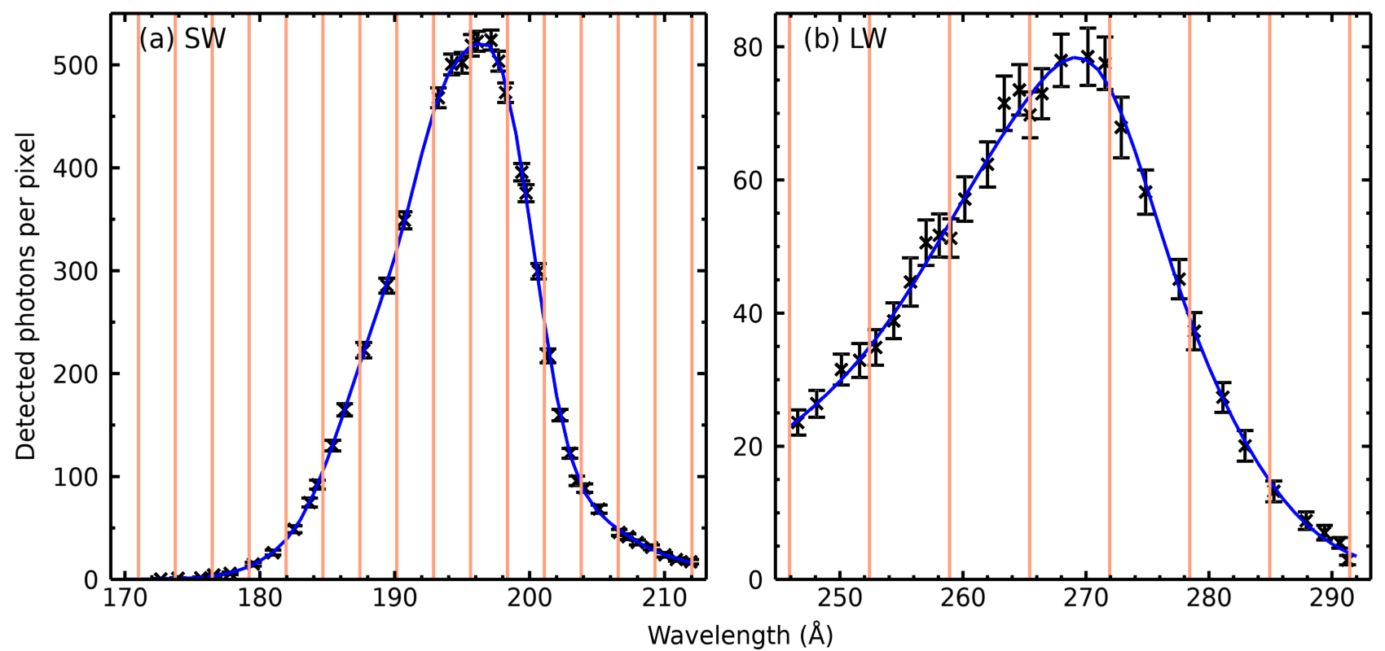
Step 1b: perform spline fit to continuum intensities
Orange lines are locations of spline nodes.

Slide 21
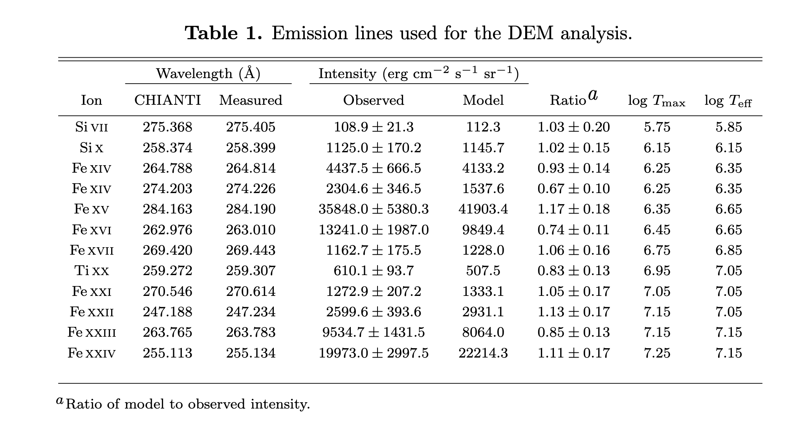
Step 2: emission lines for DEM analysis
Good coverage of hot plasma (Ti XX; Fe XXI-XXIV)
Lines fit with Gaussian function

Slide 22
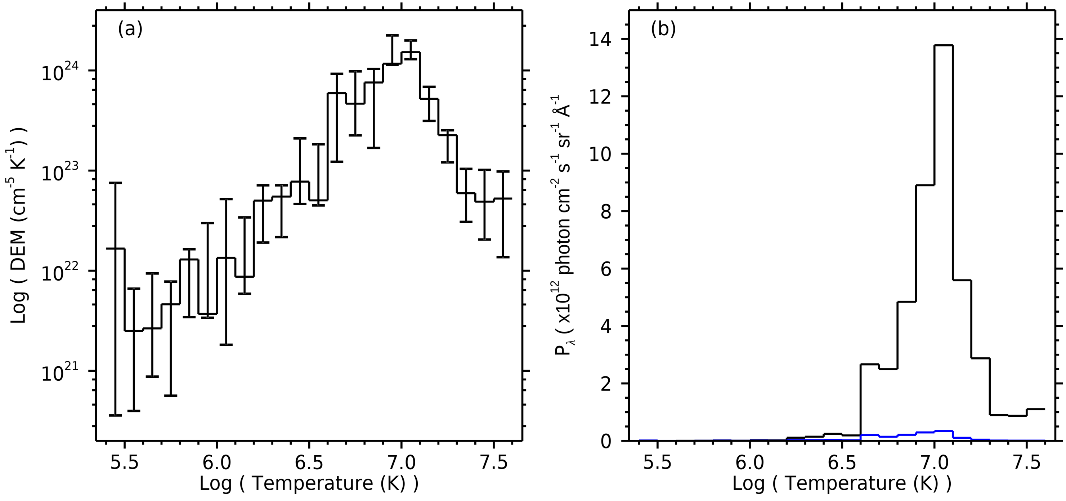
Step 3: emission lines for DEM analysis
DEM
Continuum convolved with DEM
Used the MCMC DEM method from PINTofALE software.

Slide 23
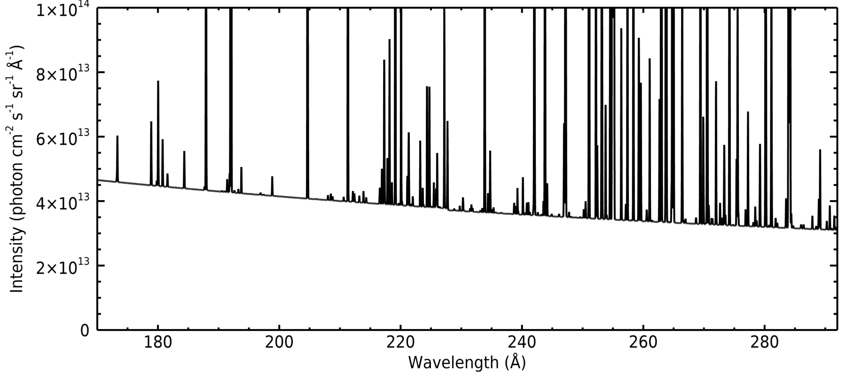
Step 4: calculate synthetic spectrum
Use CHIANTI to calculate synthetic spectrum from DEM
Note continuum is relatively flat over EIS ranges.

Slide 24
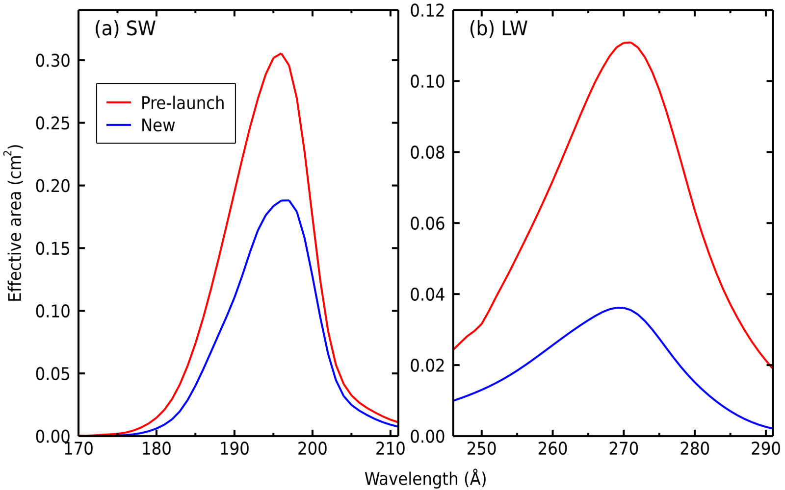
Step 5: derive effective area curves
Shapes similar to pre-launch curves.
No evidence for the “bumps-and-wiggles”.

Slide 25
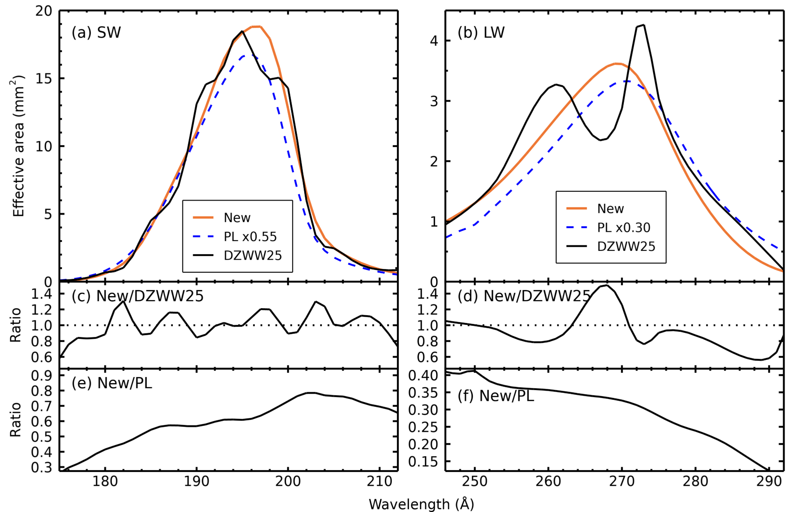
Comparison with Del Zanna et al. (2025)

Slide 26
Summary
New curves agree quite well with Del Zanna et al. (2025) – within 30% at most wavelengths.
New curves do not show the complex structure of Del Zanna et al.
Unique dataset that does not apply to earlier times in mission.
However, can be used for 2022-present period
Continuum method should be useful for MUSE and EUVST.

Slide 27
Element composition
DEM is dominated by plasma at 10 MK.
DEM shape is driven by iron ions (Fe XXI-XXIV).
The DEM predicts the strength of the continuum but depends on choice of element abundances.
Continuum is dominated by hydrogen: collisions of protons with free electrons.
Allows the Fe/H relative abundance to be measured.

Slide 28
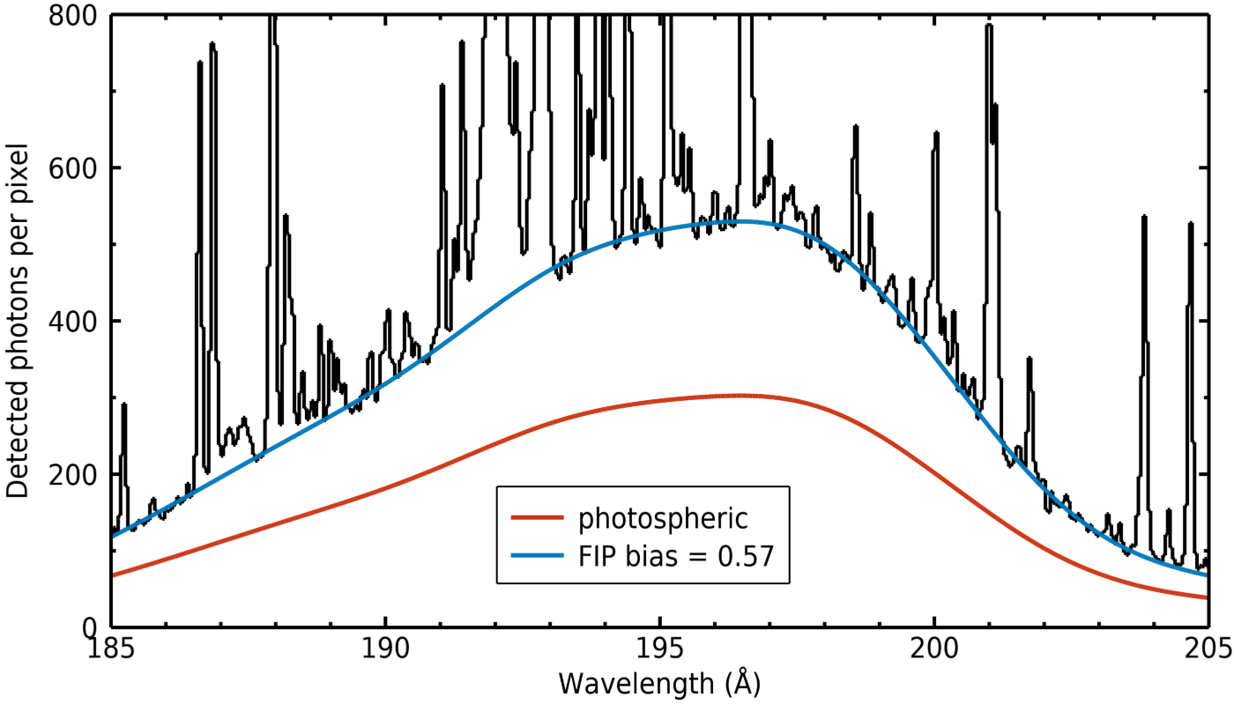
Adjust abundances to match observed continuum level
FIP bias of 0.57 (i.e., “inverse FIP effect”) gives best match

Slide 29
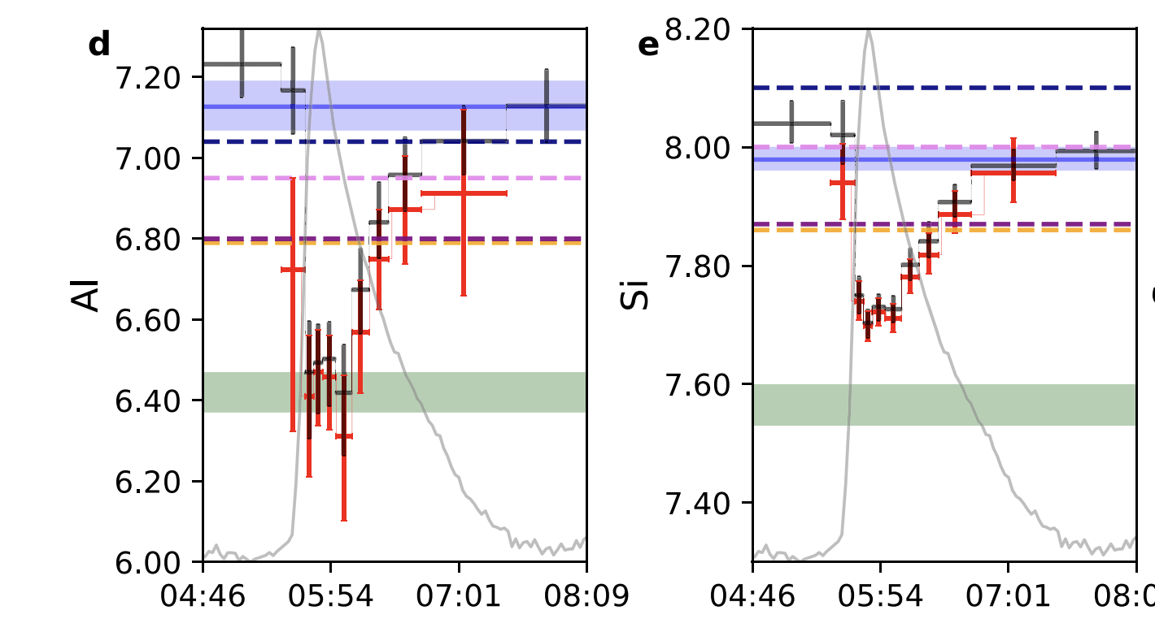
Validating abundance results
Line-to-continuum ratios are routinely used for FIP bias measurements at X-ray wavelengths.
The X-ray Solar Monitor (XSM) on Chandrayaan-2 measures the full-Sun solar X-ray spectrum at high time cadence.
Variation of Al and Si abundances with time for a B-class flare (Mondal et al., 2021, ApJ)

Slide 30
XSM results for 30-Sep-2024 flare
Derived Fe/H ratio is 0.55, compared to 0.57 from EIS

Slide 31
Final summary
First study of the EUV flare continuum using EIS data.
Enables EIS effective area curves to be derived.
Generally good agreement with Del Zanna et al. (2025).
DEM analysis of lines and continuum yields Fe/H FIP bias of 0.57.
Analysis of simultaneous X-ray data gives Fe/H FIP bias of 0.55.

